Slide 1

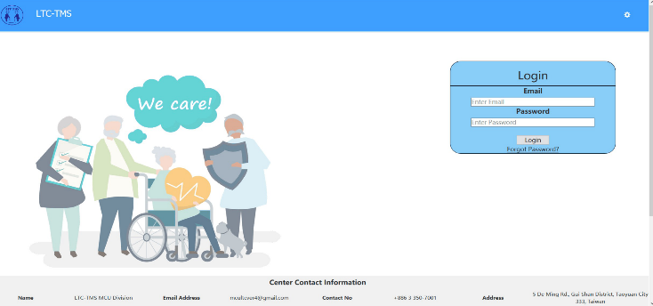

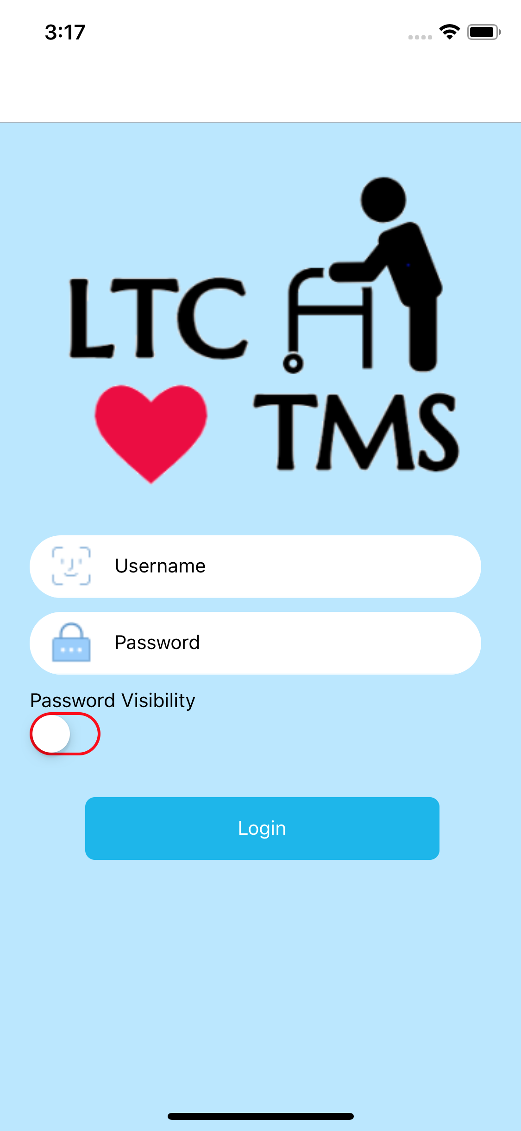
LTC-TMS v 2.1 Final Report
Long Term Care
Task Management System
Class of 2020
Ming Chuan University
International College
Applied Computing Program

Slide 2
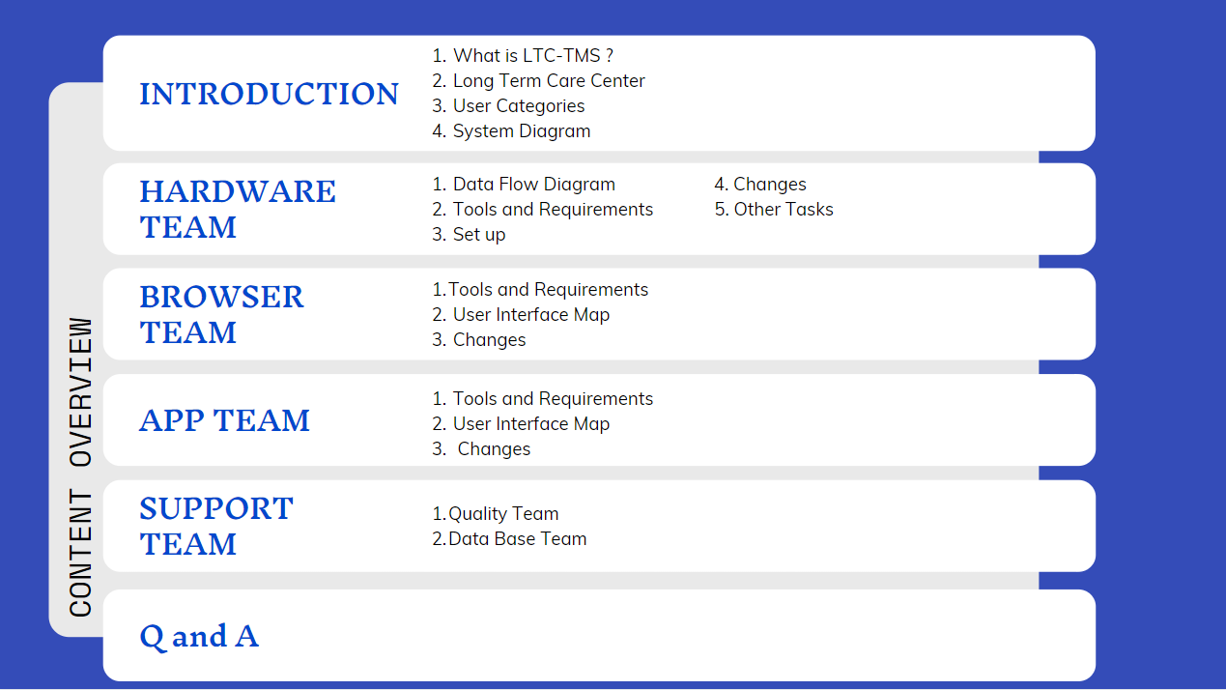
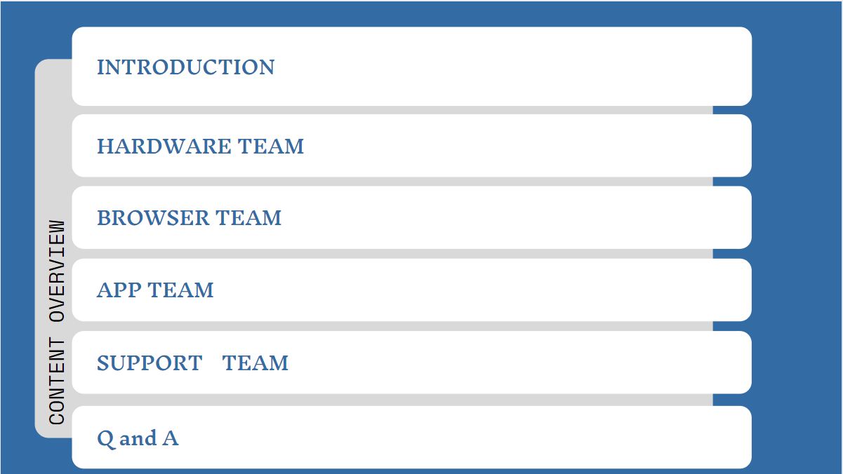

Slide 3
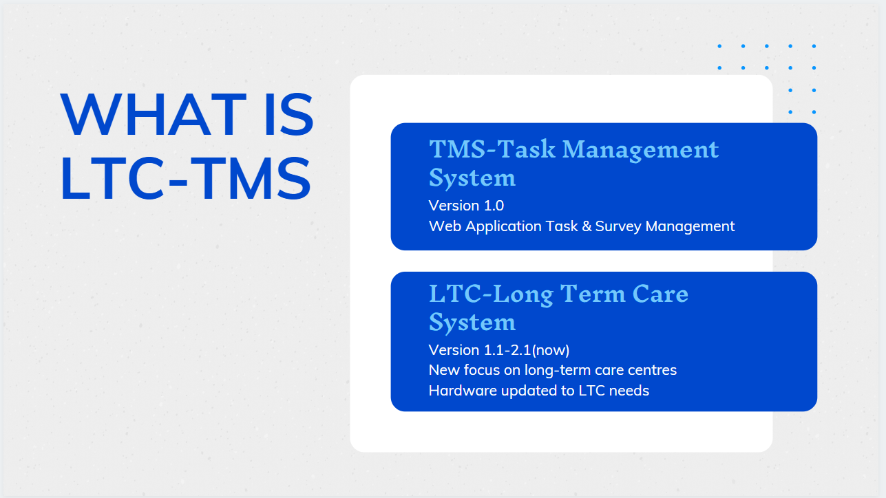
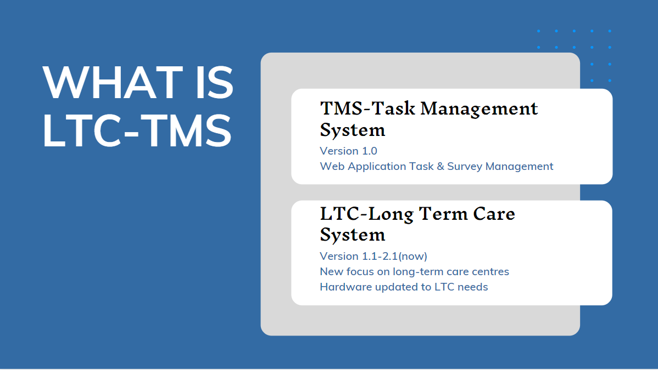

Slide 4
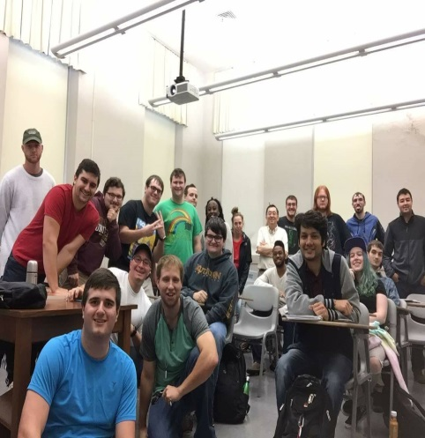
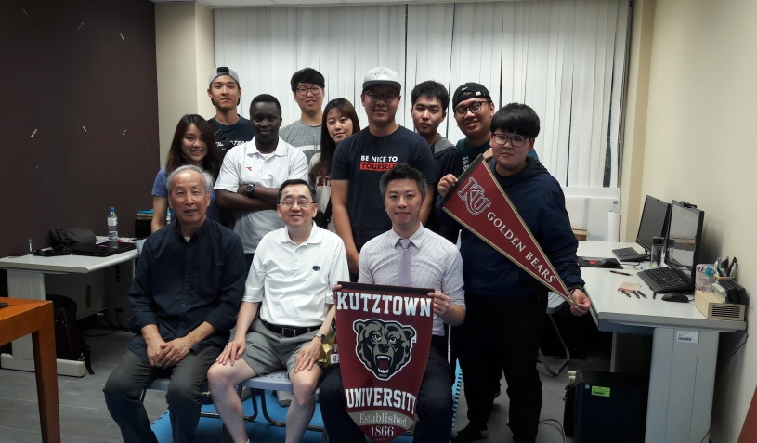
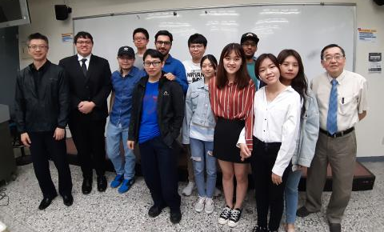


2018
v 2.0
v 2.1
v 3.0
v 3.1
v 1.0
v 1.1
2019
2020

Slide 5

VISIT LONG-TERM CARE CENTER
廣恩老人養護中心 Guannenn Nursing Home Foundation
Time : 2019/07/18 14:00-16:00
Group Member : Angela, Eva, Andre, Kevin, Francois
Goal : Get the information about LTC work
Notes:
Angela
I organize the visit to know the real situation of Long term care canter. We prepared questions in four direction, including Daily Operation of center/Care Center for the care of elderly/The system used by the LTC Center/The contact way of LTC center and family member.

Slide 6
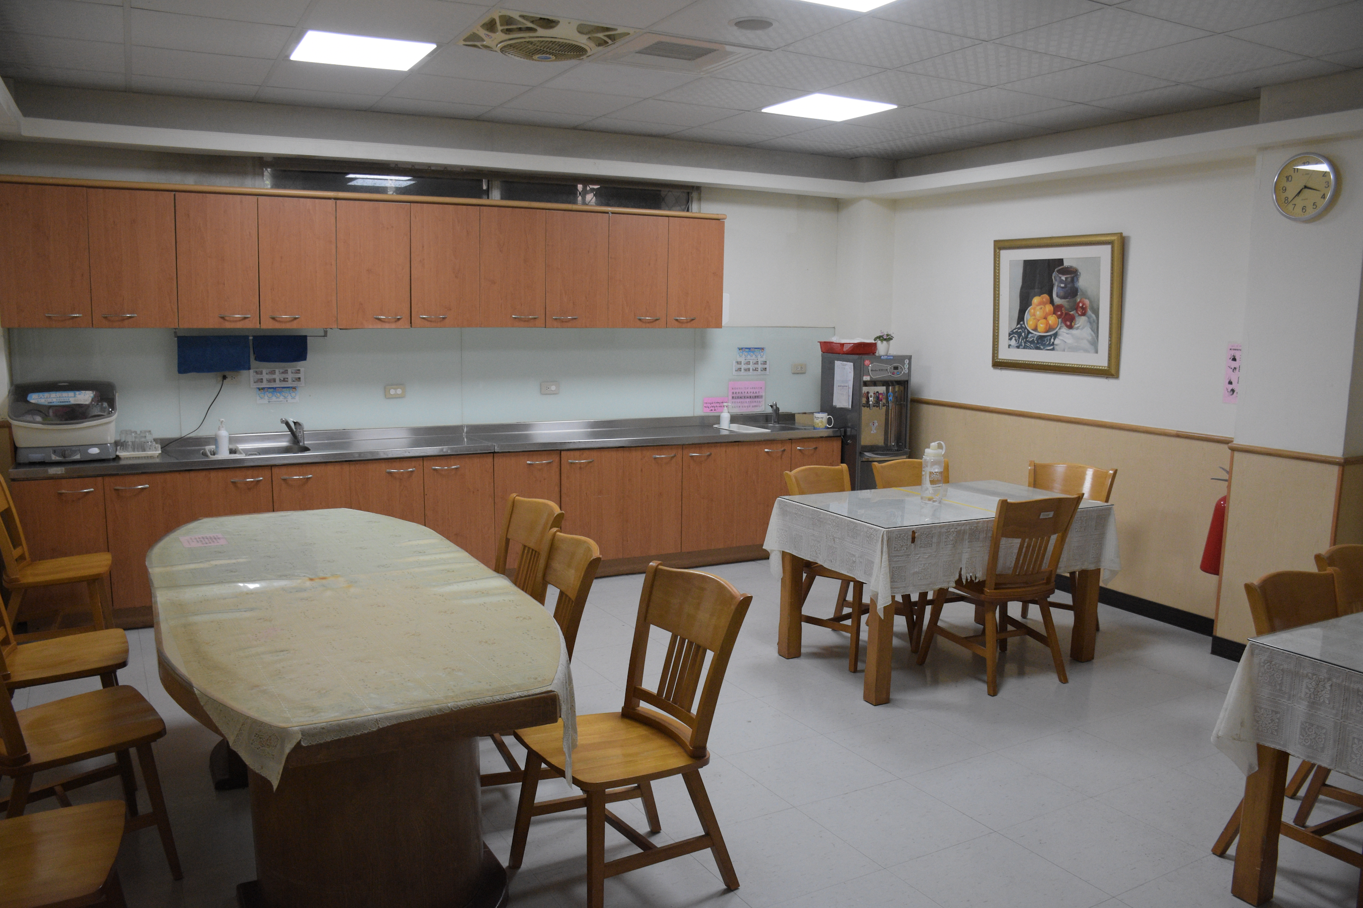
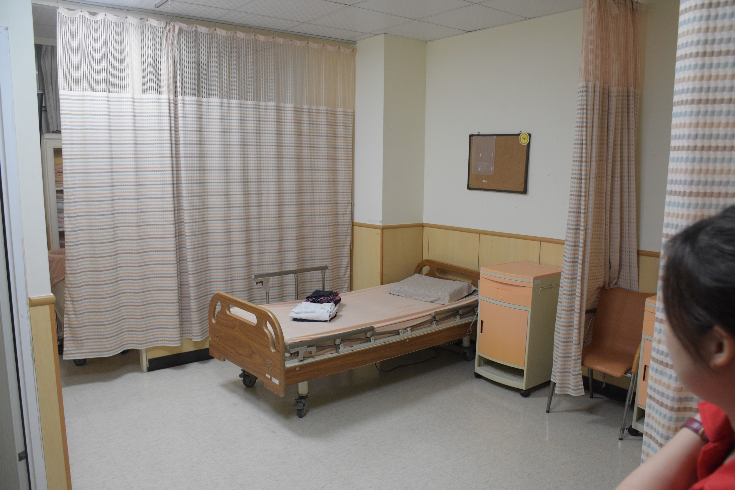
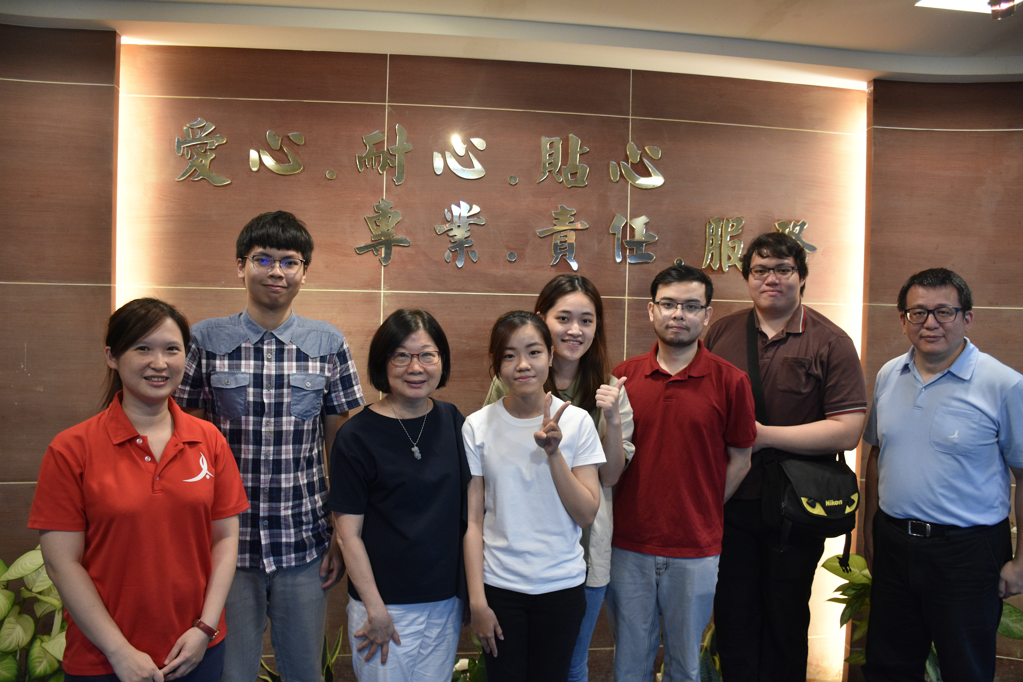
PHOTOS
Notes:
Get the information about LTC Work.
In the Long term care center, we realise they don’t have database and their hardware is reality. They use handwriting in record for the patient status. We received the daily record paper and will change our system based on that.

Slide 7





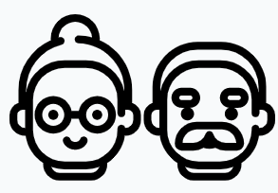



USERS
Director of
Nursing
Patient
Certified Nursing
Assistant
Chief Nursing
Officer
Family
IT Admin

Slide 8



USER CATEGORIES
BROWSER COMPONENT
Director of Nursing
(Director)
Chief Nursing Officer
(CNO)
IT Admin
HARDWARE COMPONENT
MOBILE APPLICATION COMPONENT
Resident
Certified Nursing Assistant
(CNA)
Family and Friends of Resident
Certified Nursing Assistant
(CNA)
Notes:
Users of this system in each component.

Slide 9
System Diagram
Database
Base Station
Application
🔃
Web Portal
Wearable

Slide 10
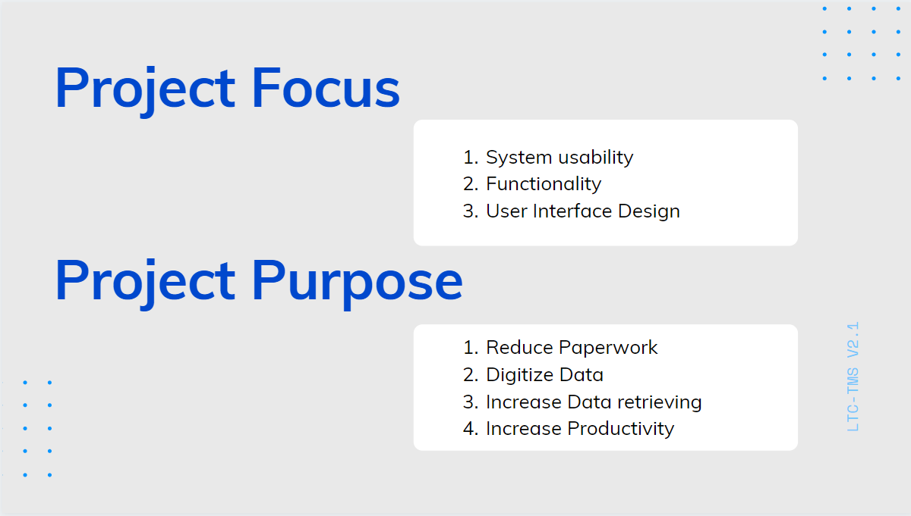

Slide 11
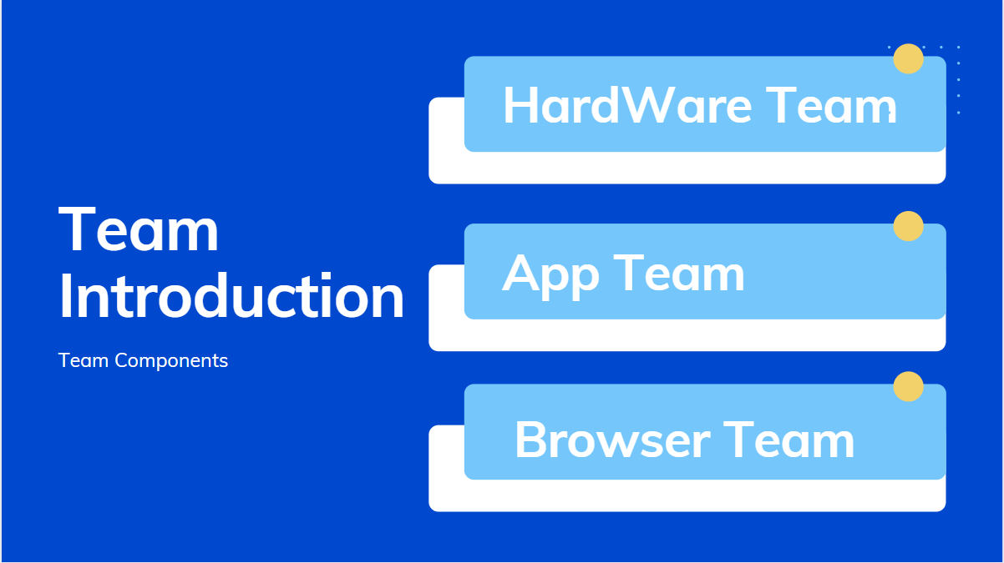

Slide 12
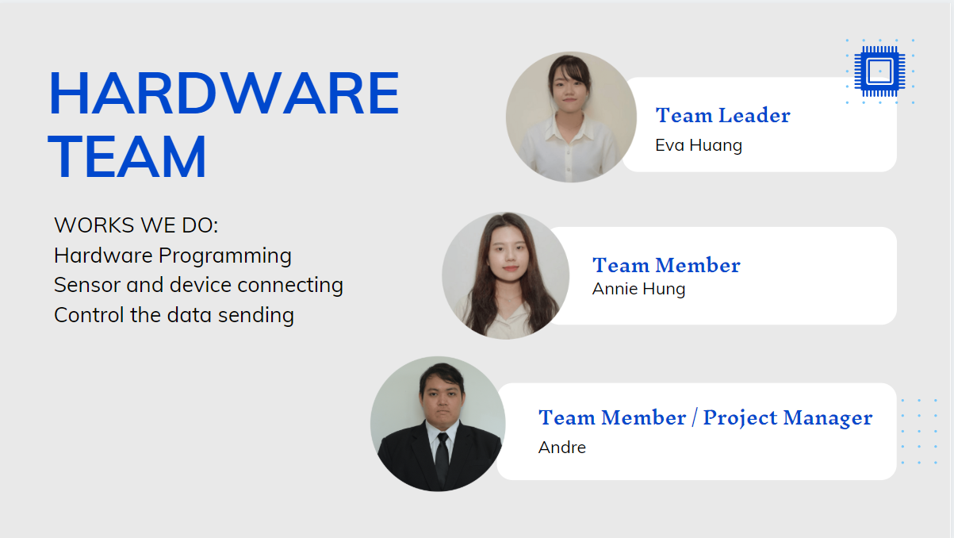

Slide 13
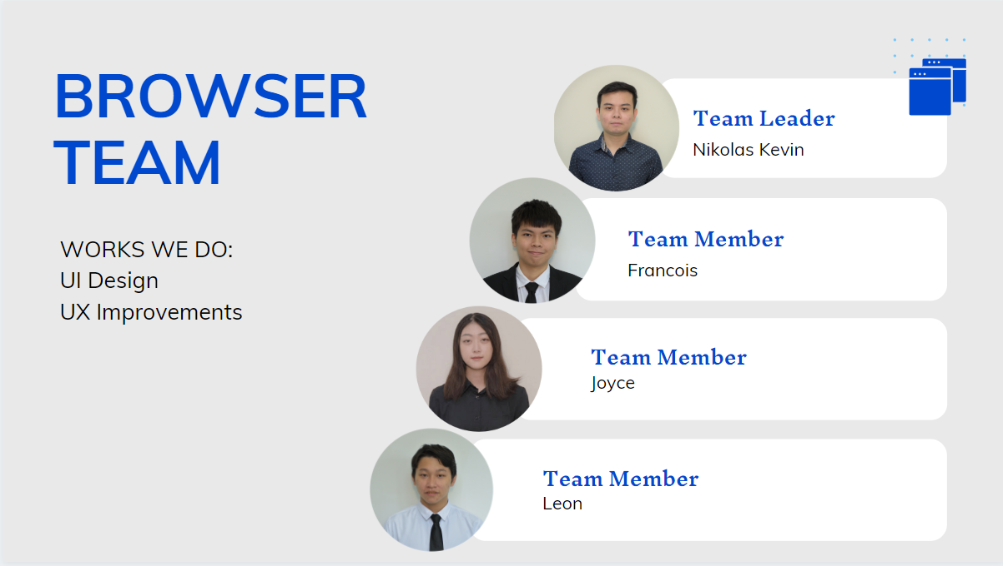

Slide 14
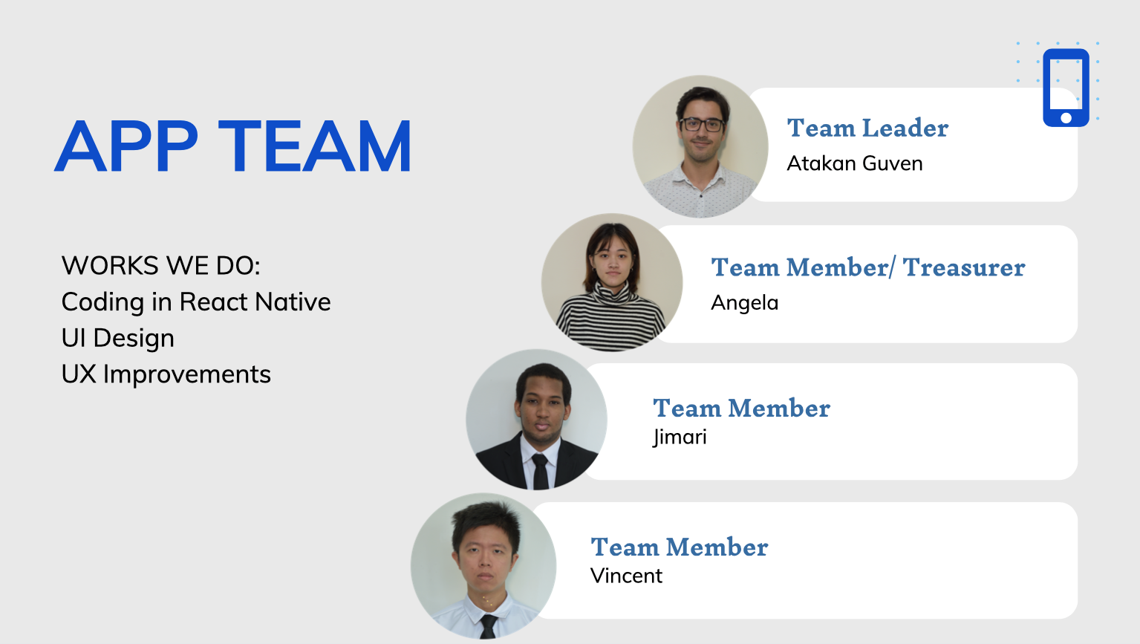
Notes:
unified theme
function improvements
user friendly app

Slide 15
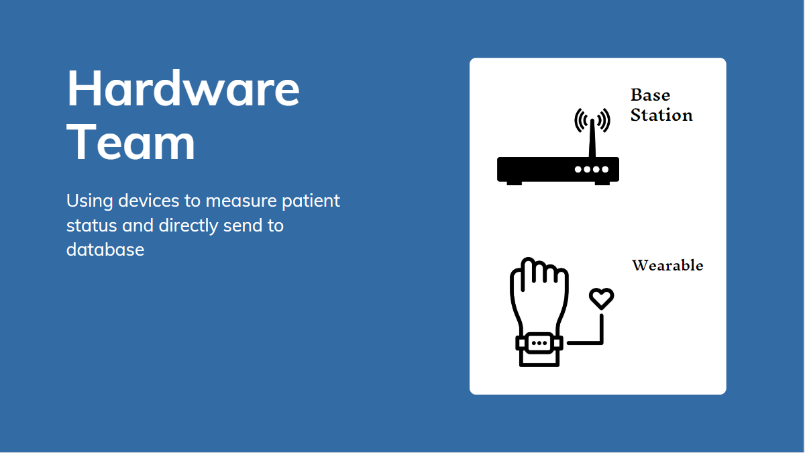
Notes:
e
we seperate the hw device into two part one is base station another is wearable devices, base station is to collect the data from the wearable devices

Slide 16
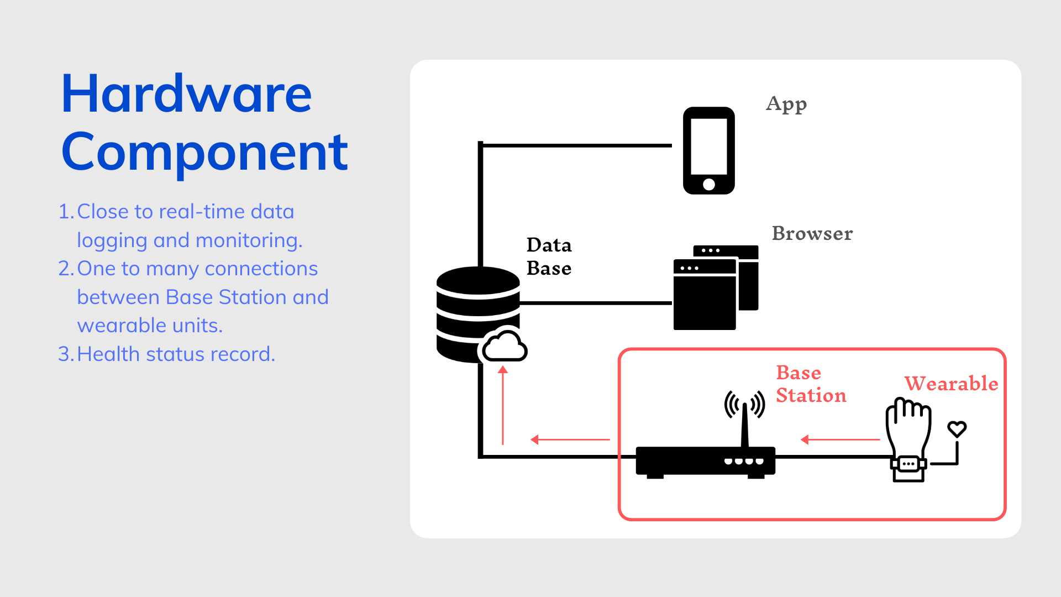
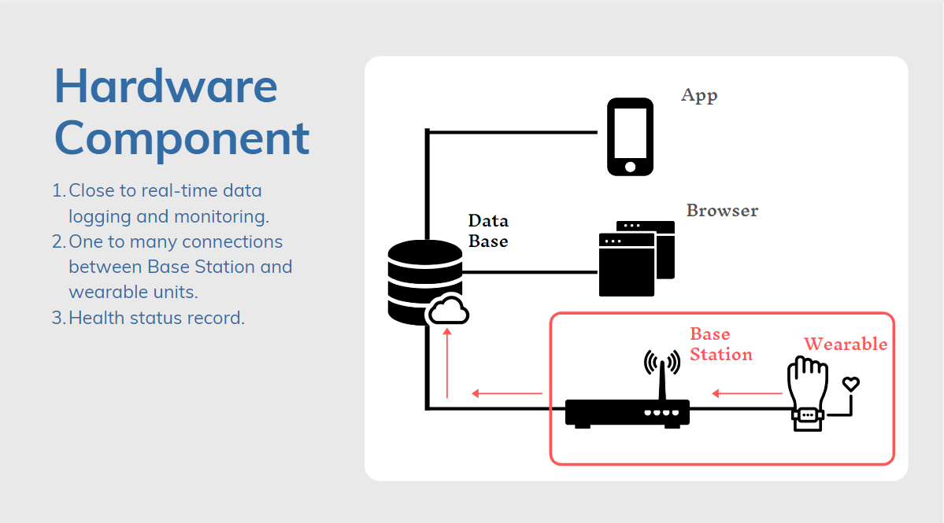

System Diagram
Database
Base Station
Application
🔃
Web Portal
Wearable
Notes:
bring back to system diagram
clarify the part hw is handle
input session of the project
server-based network structure
IT infrastructure- hardware components management

Slide 17
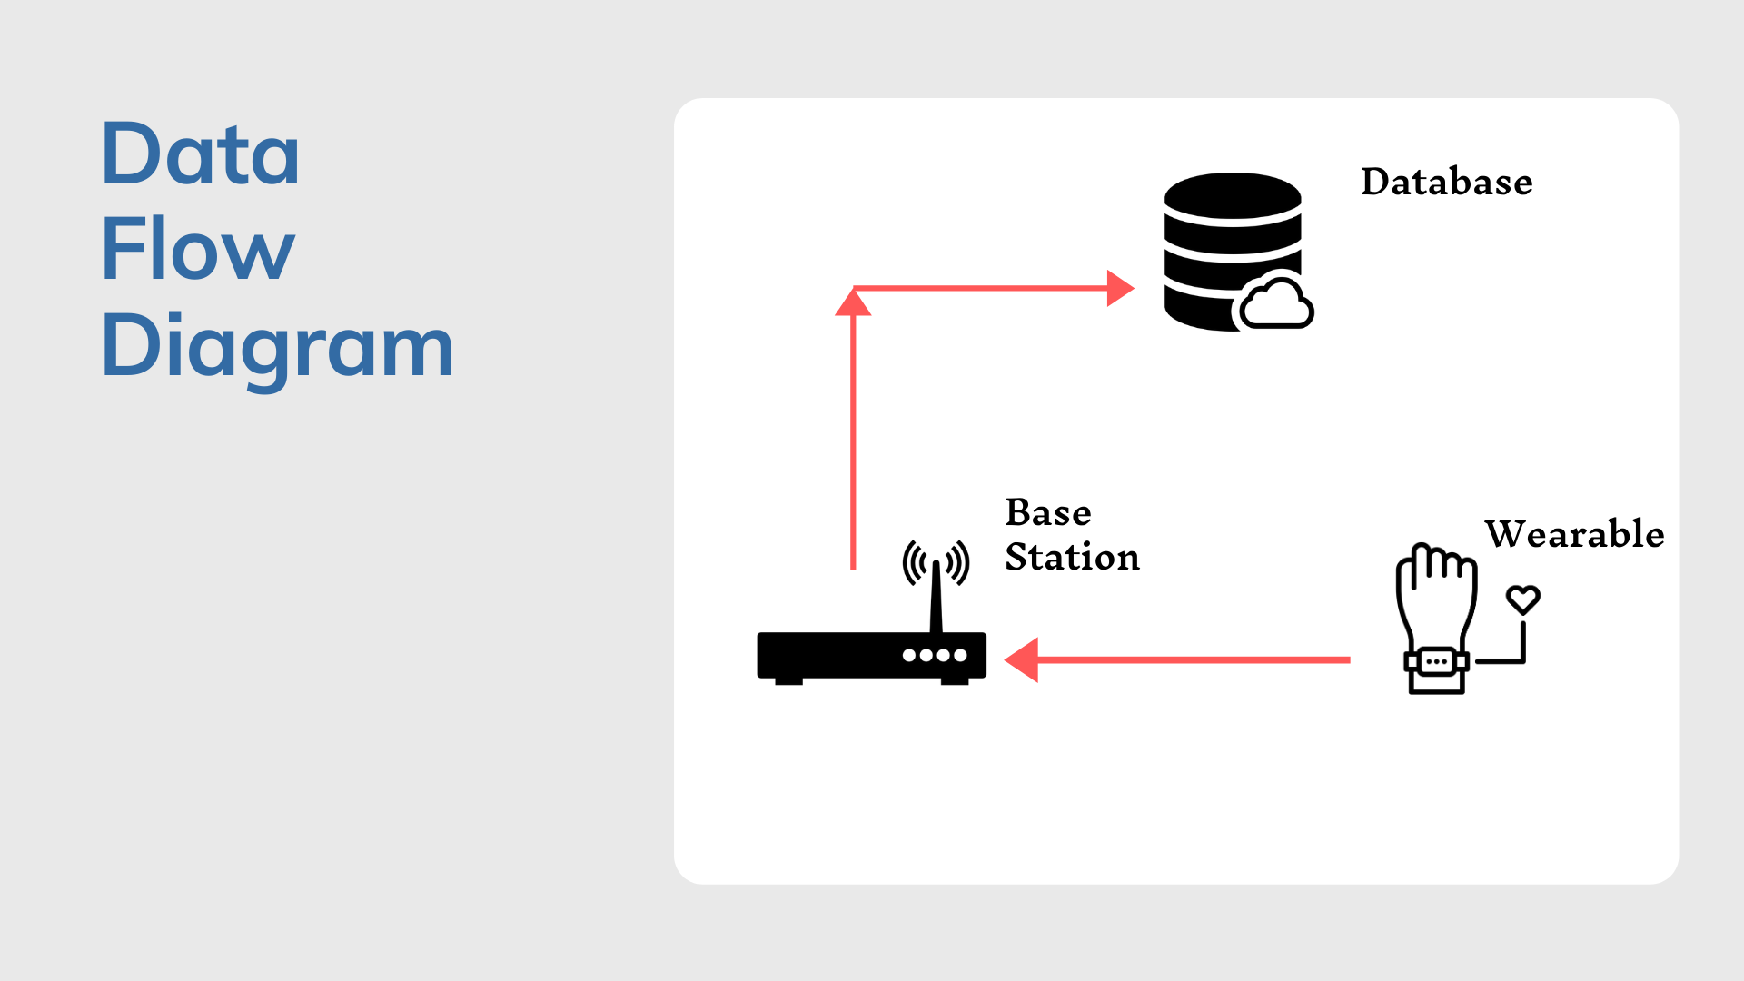

Slide 18
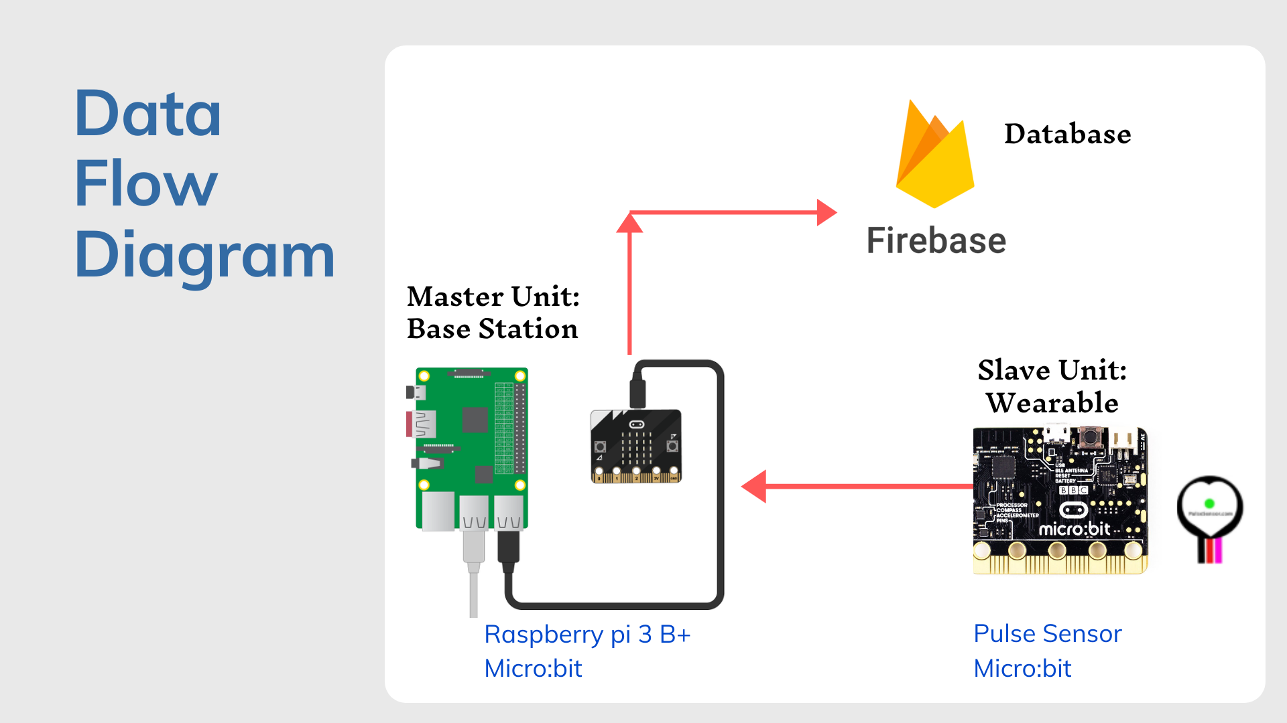

Slide 19
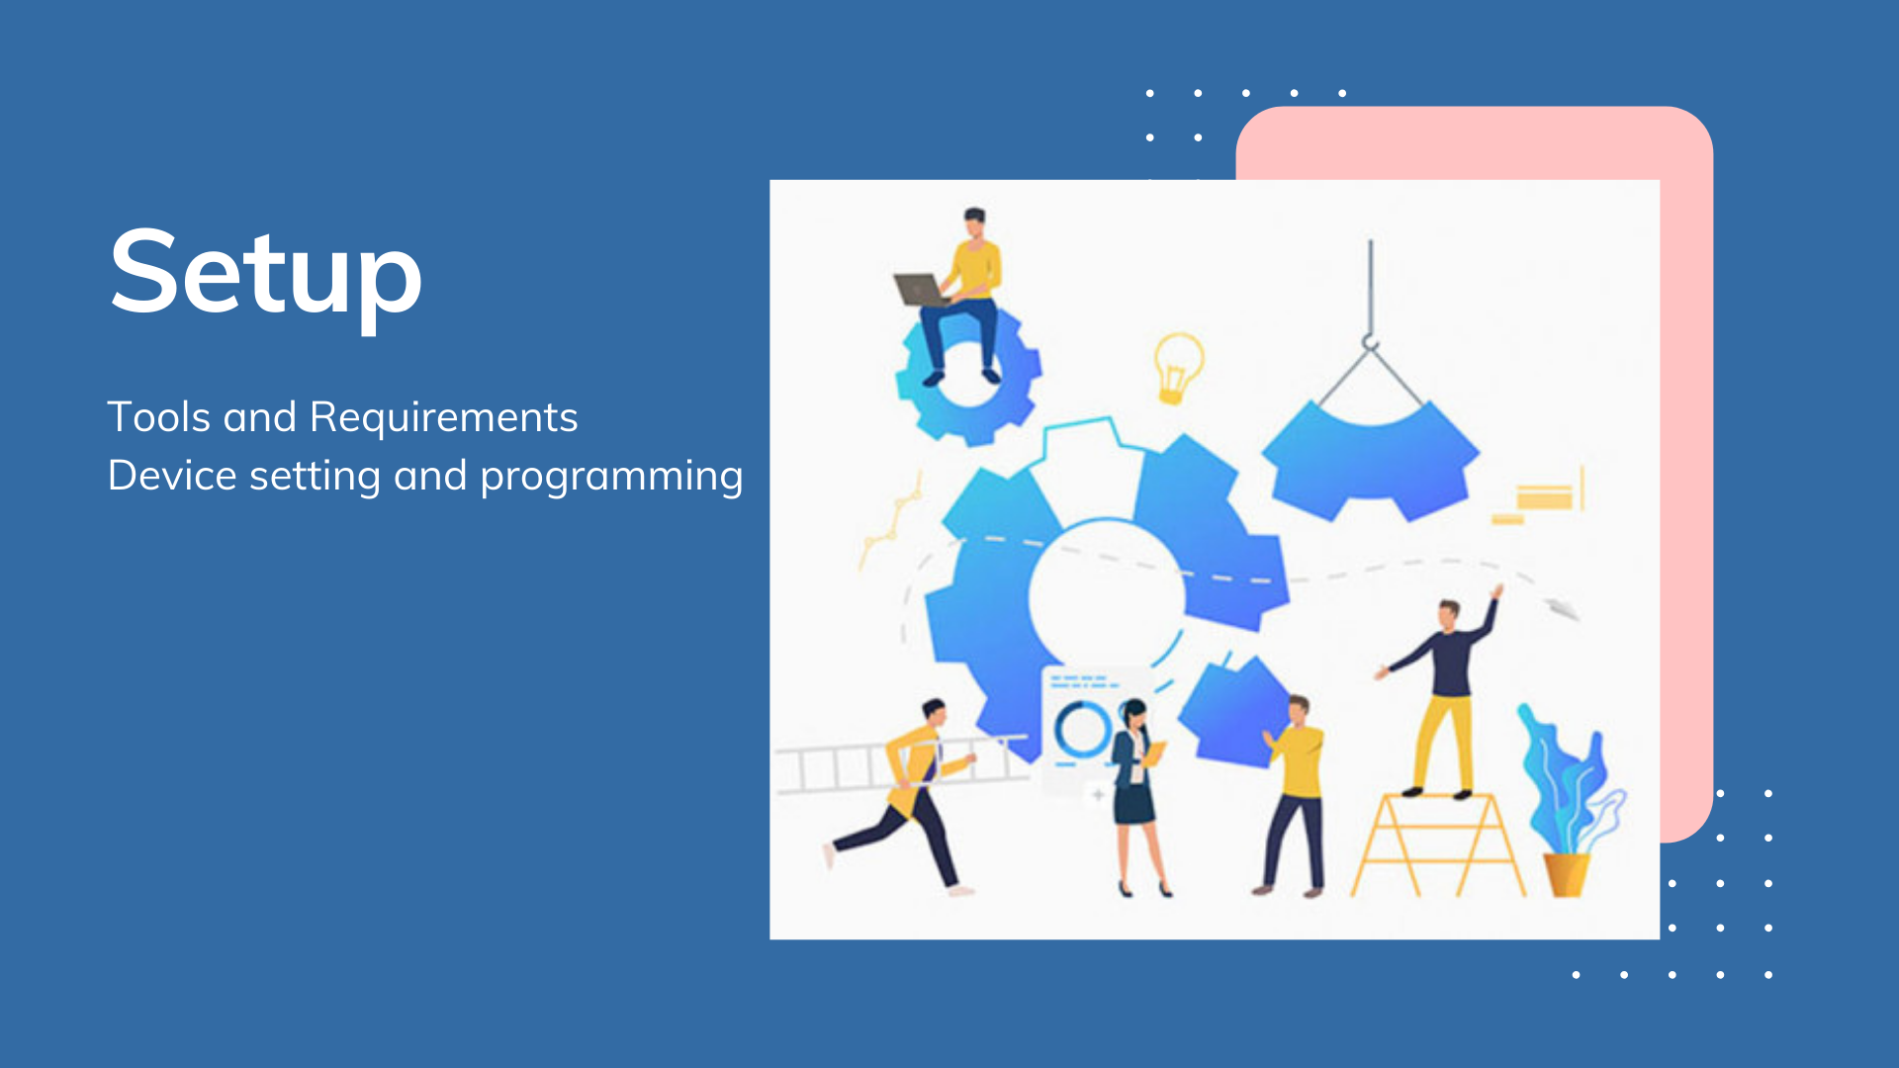

Slide 20
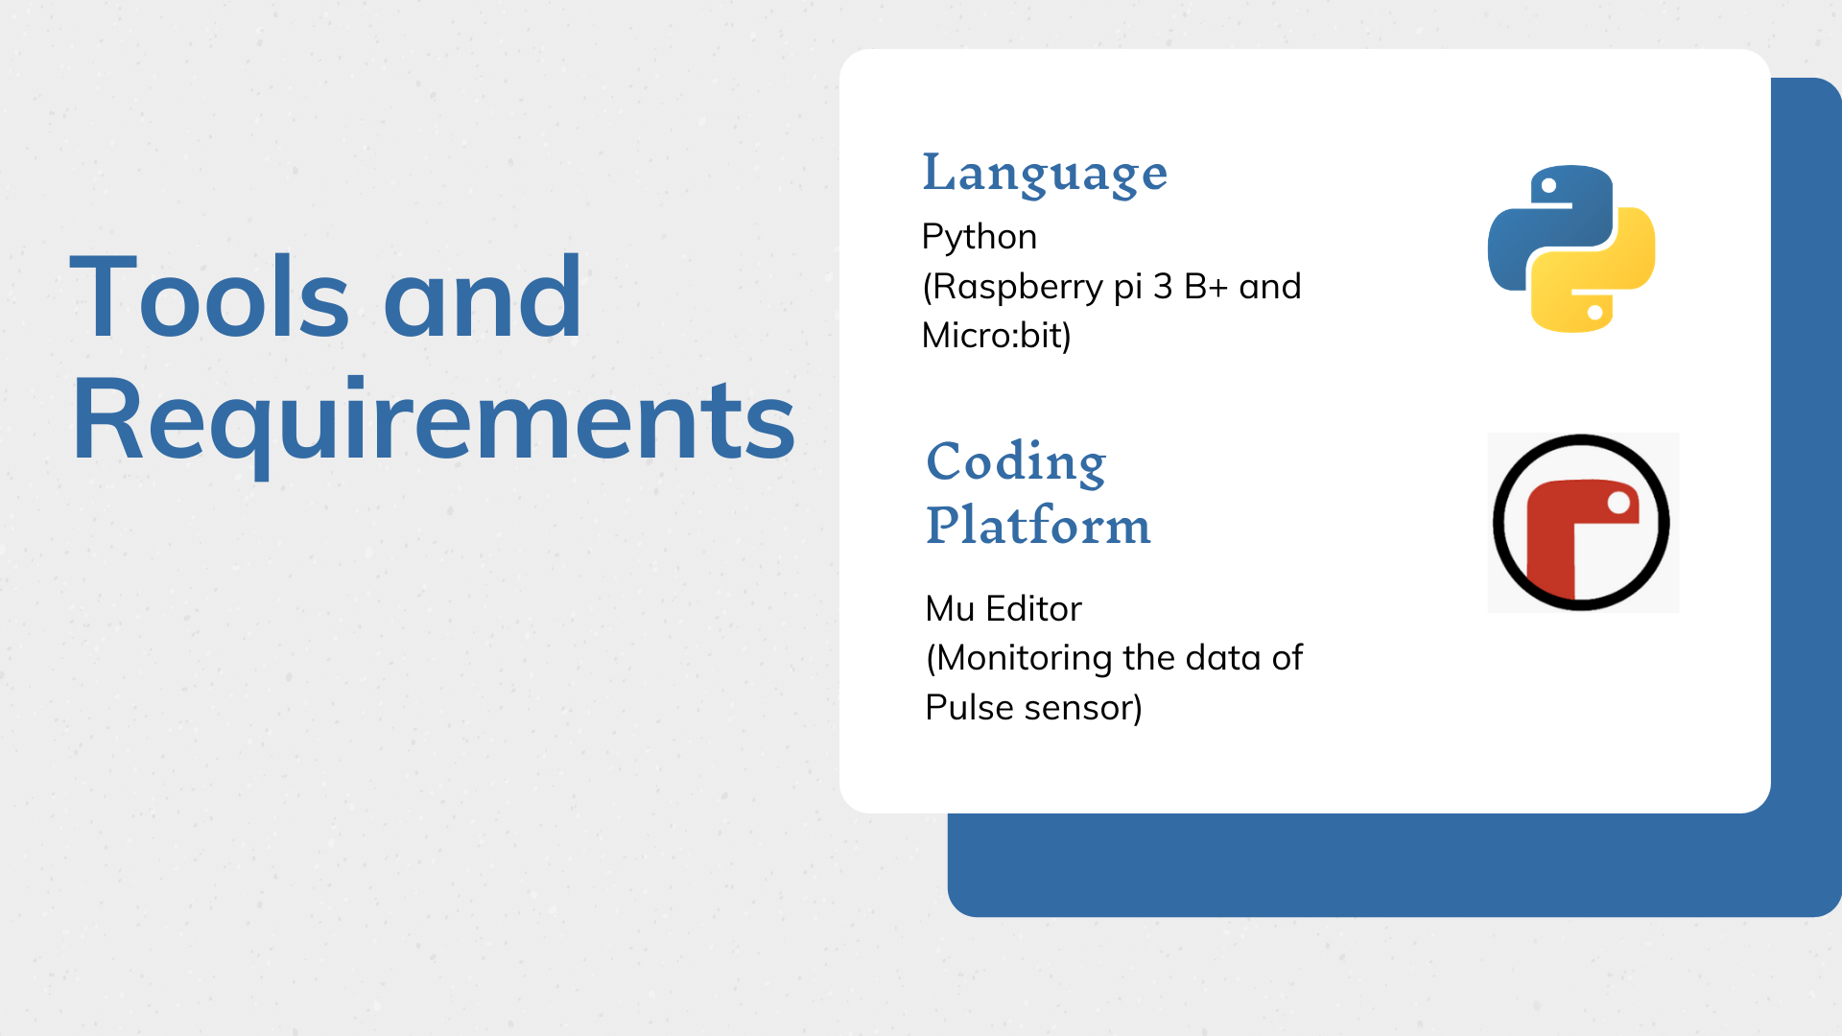
Notes:
annie
“We using Python to code our Raspberry pi an micro:bit. The difference between this two is the file format. About our coding platform the Mu editor can run python file and show the result on the monitor”

Slide 21
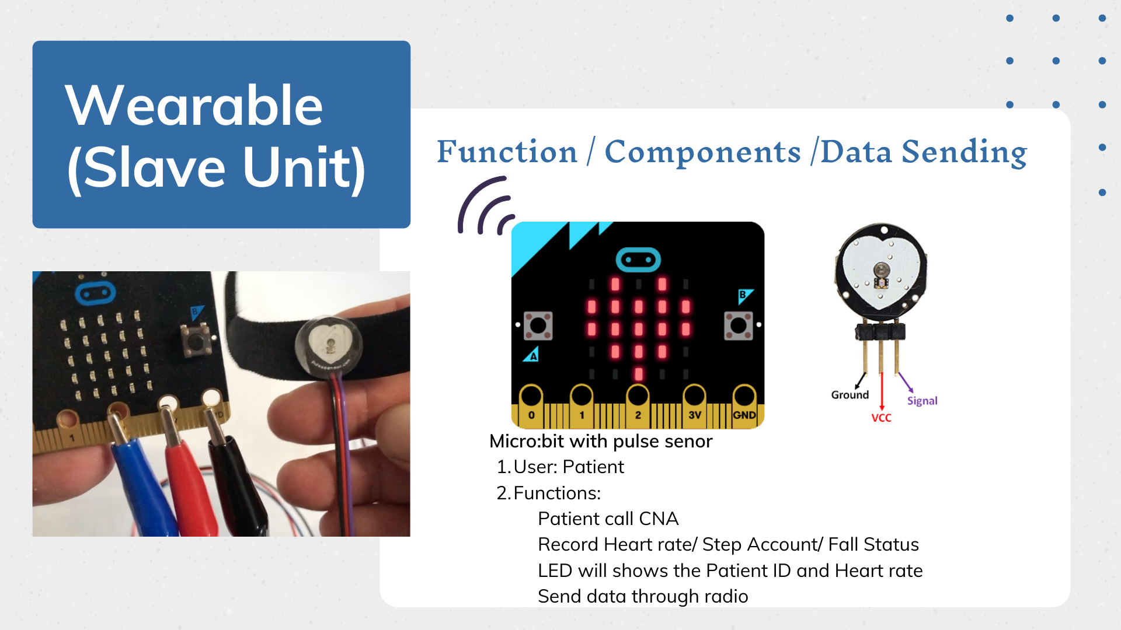
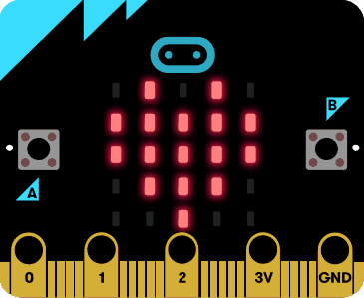
Notes:
annie
“Explain Master and Slave unit
Functions”

Slide 22
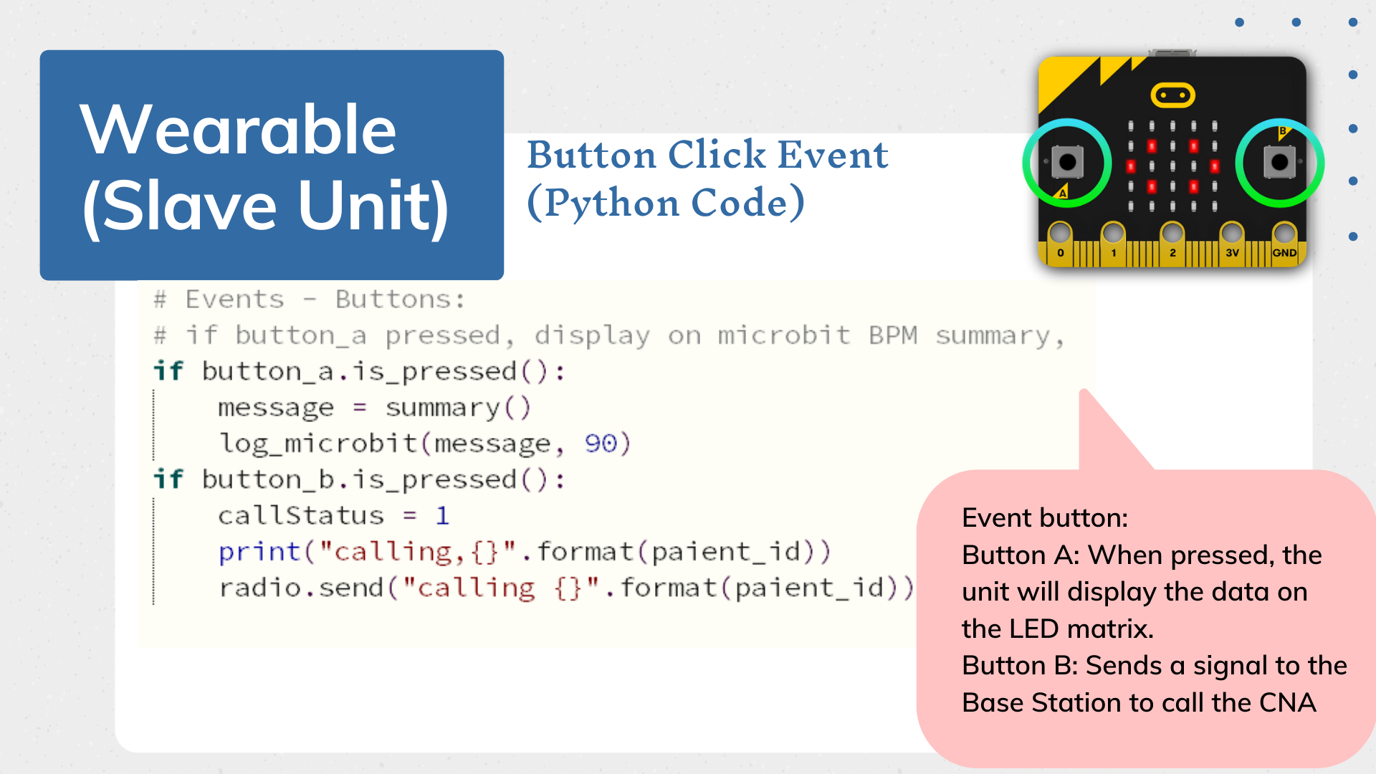
Notes:
annie

Slide 23
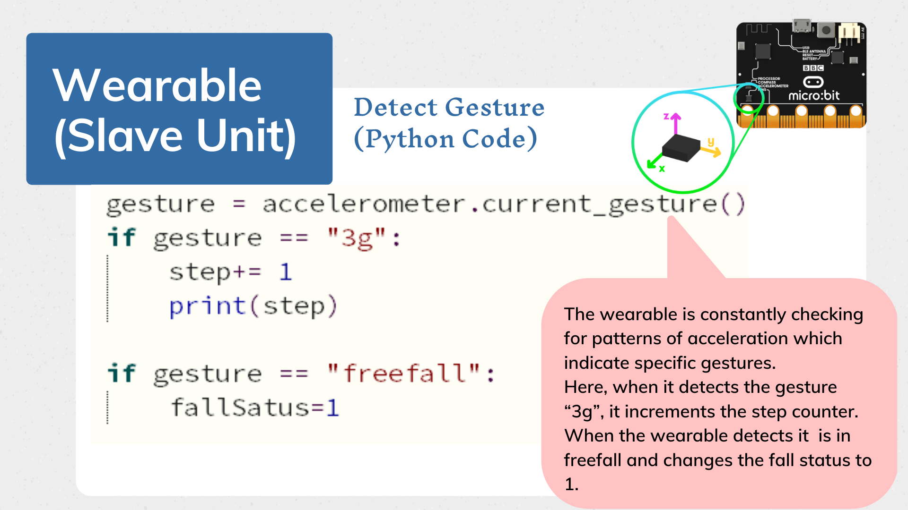
Notes:
annie
“Accelerometer
on the Micro:bit is able to recognise the gestures.If you move your BBC micro:bit in a certain way (as a gesture) then micro:bit is able to detect this. When gesture detect it is 3g we will count as step account and if the gesture detect it is in freefall it will change the fall status. ”

Slide 24
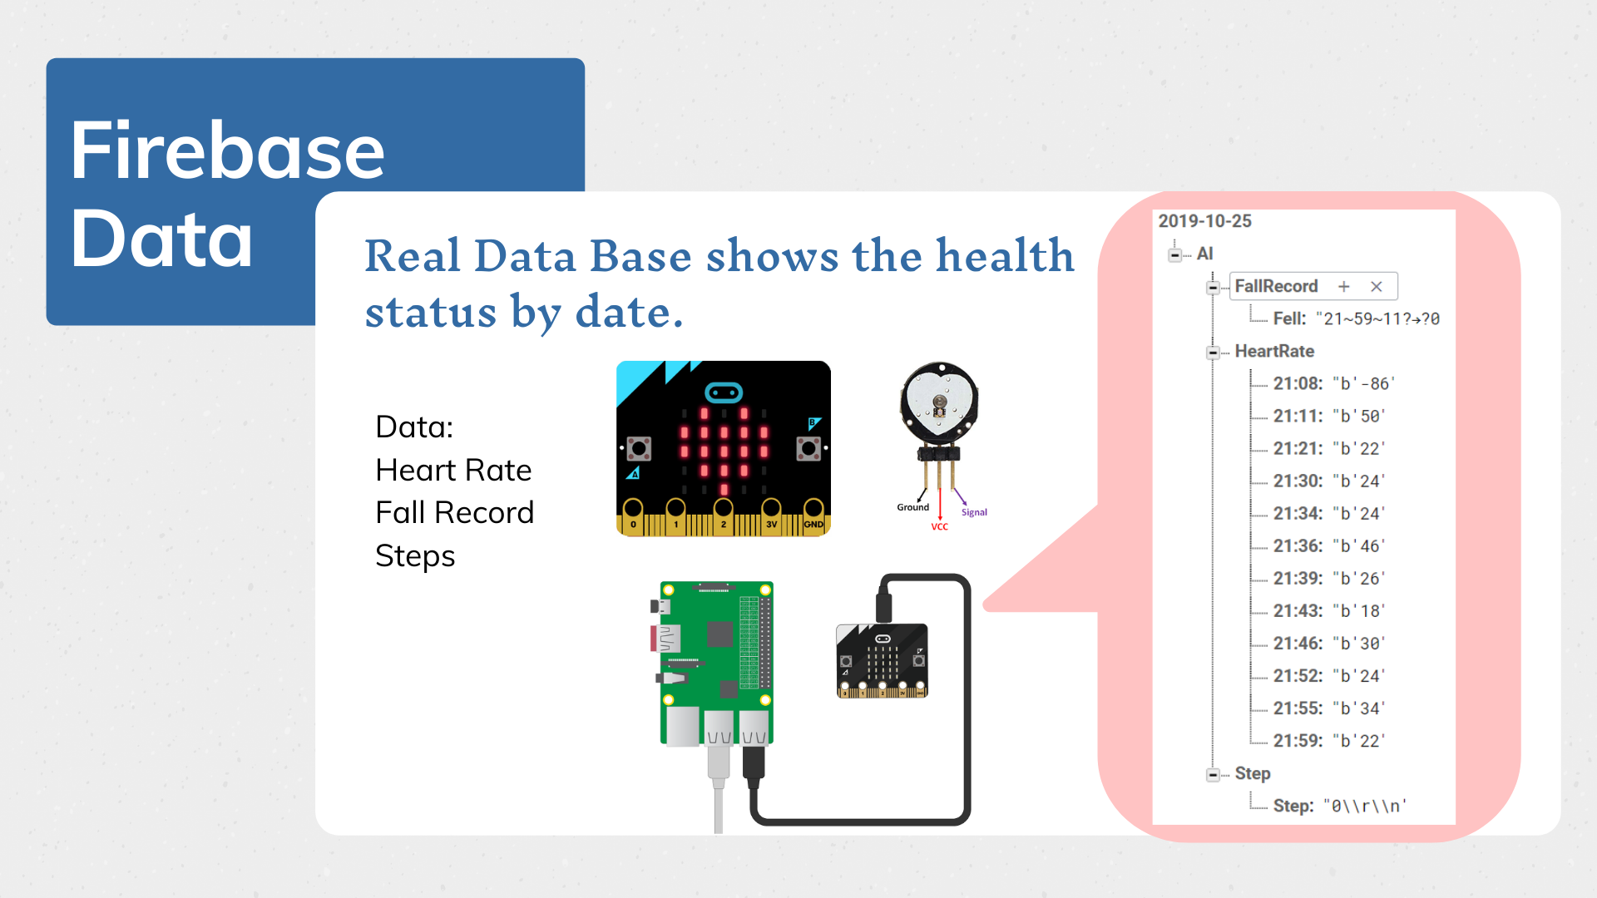
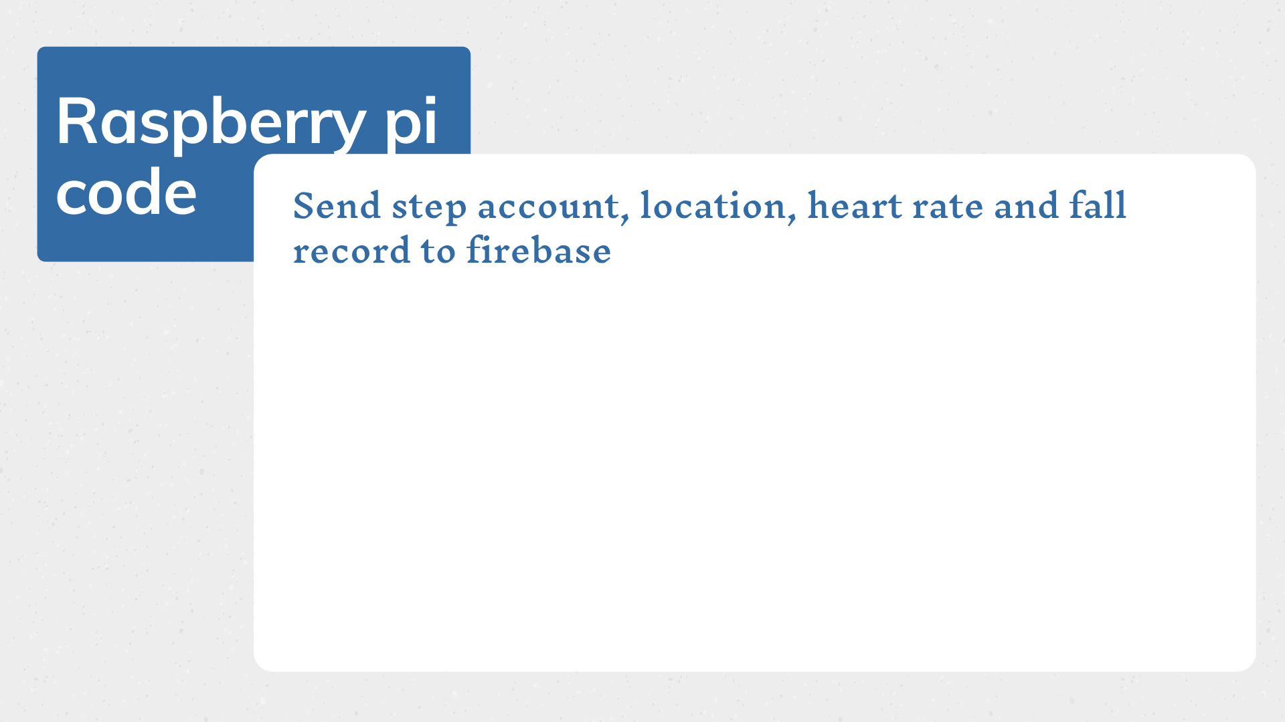

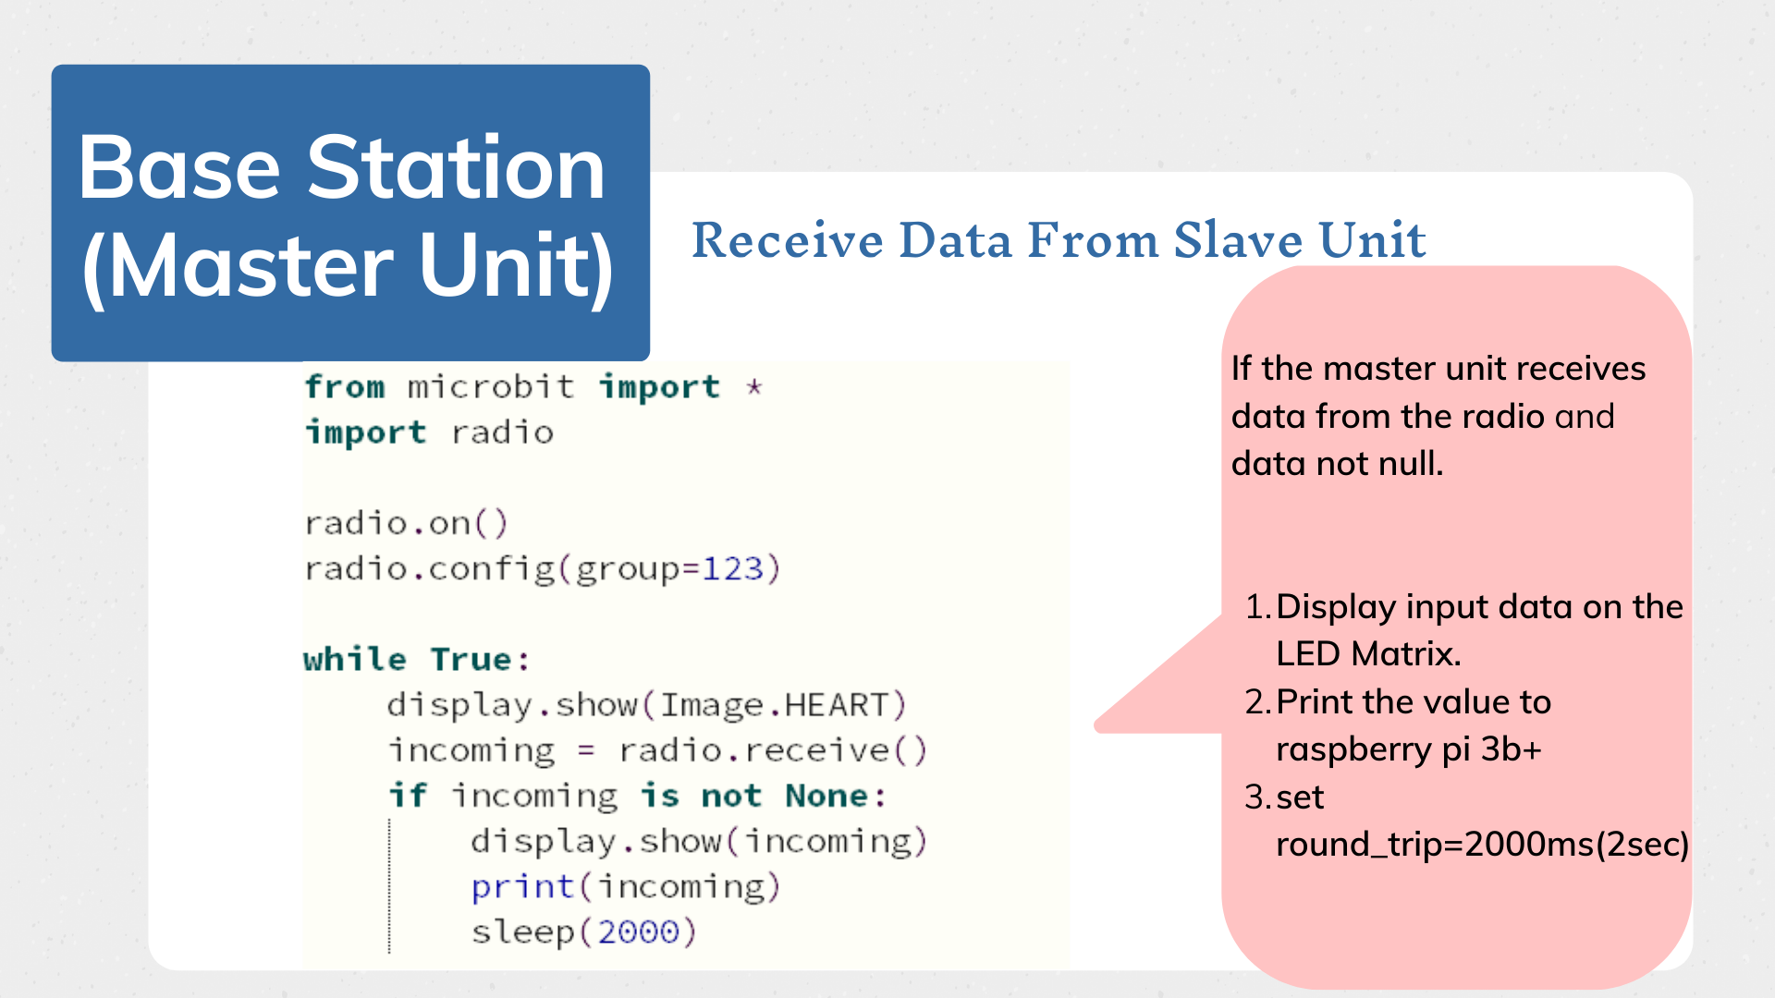
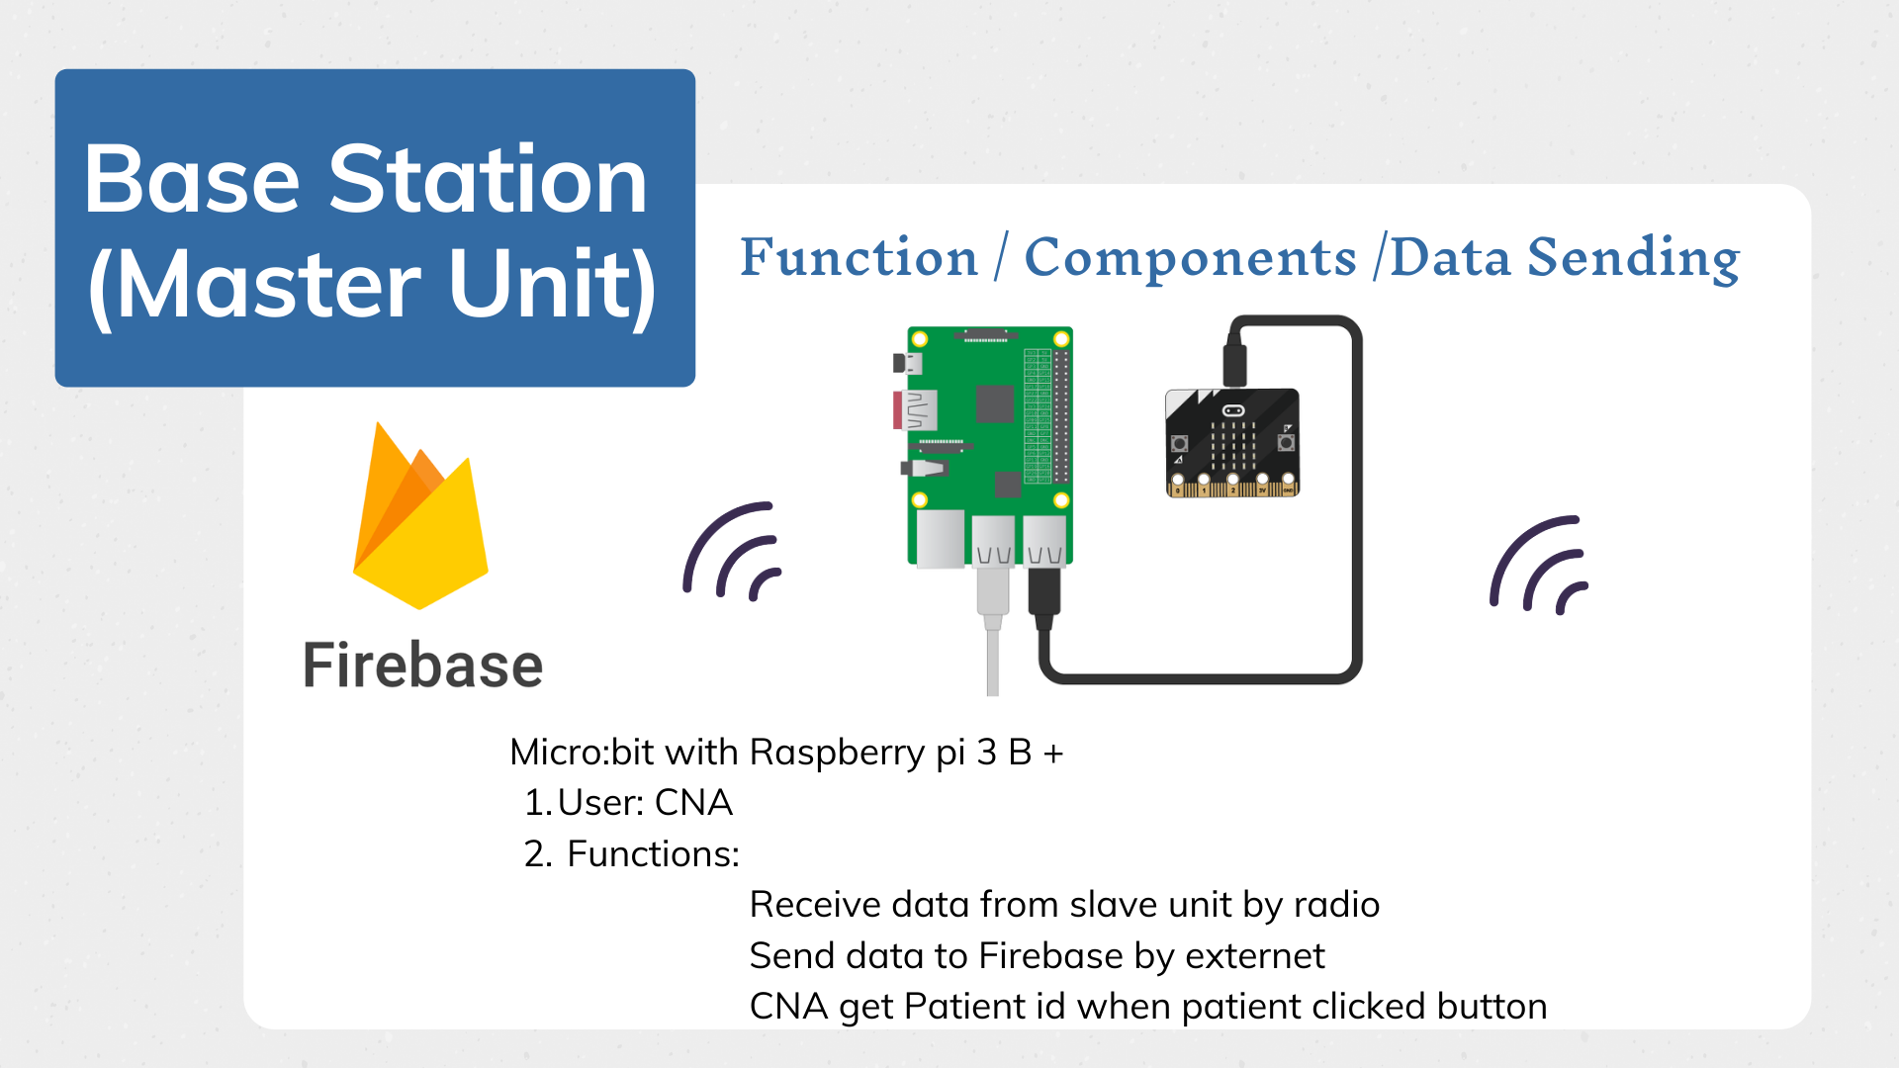
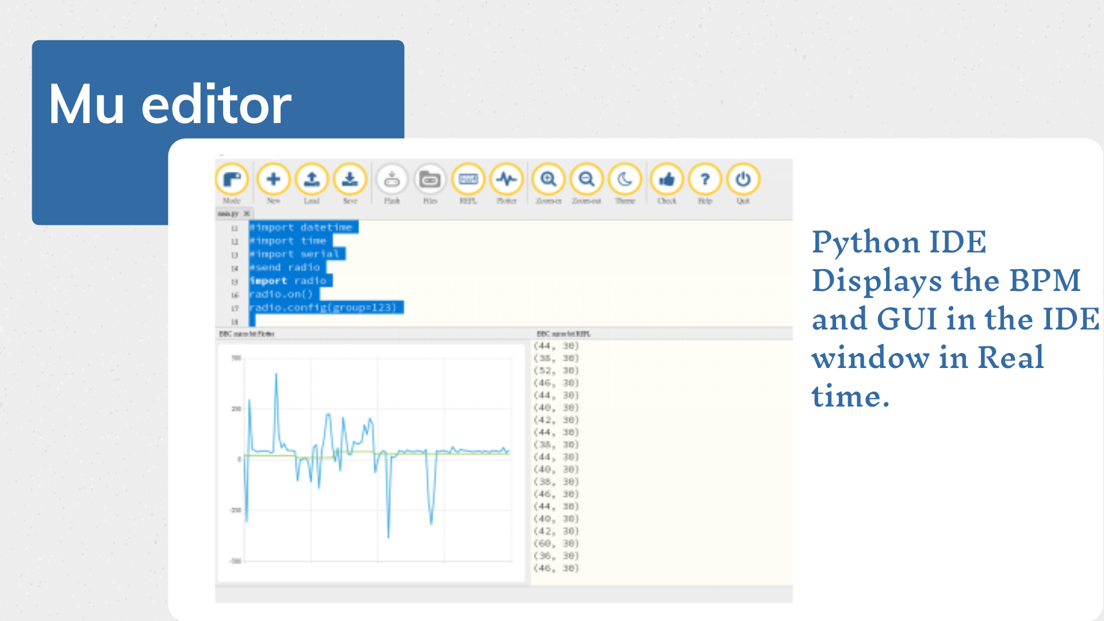
Notes:
annie
“ a real time generated the live graph of the data output”
slave: for resident’s gui monitoring
we implement it in mu ide platform to monitor the gui.

Slide 26
Notes:
as to change the platform from last version we add the new code of each component to let the flexibility and debug process more easier
we also set the time to let the loop be separated and do the things all over again every 2 seconds.

Slide 27
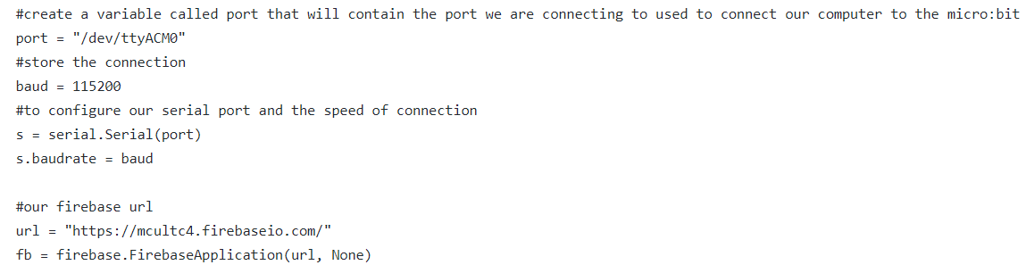
Get the data from Micro:bit through the port
Notes:
we operate the master unit on the raspberry pi
after master unit transmit the data through ethernet - bus topology network

Slide 28
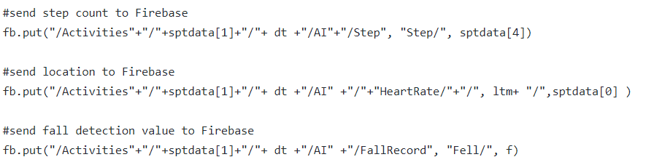
Send step account, location, heart rate and fall record to firebase
Notes:
raspberry pi generate the required data into a package send to real time database firebase

Slide 30
Industry Conventions
Current market products
Improve scalability

Slide 31
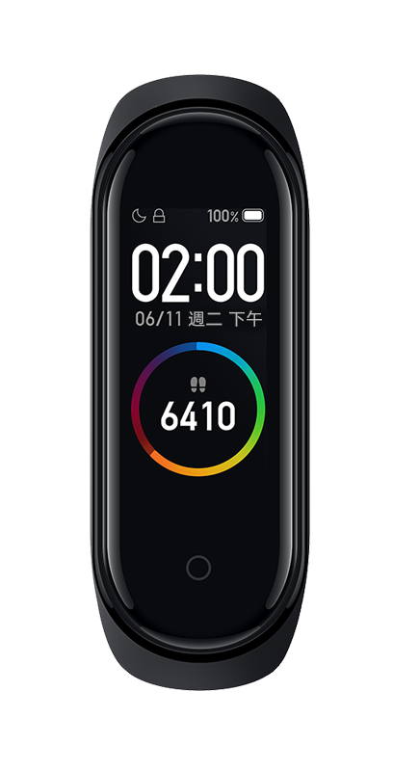
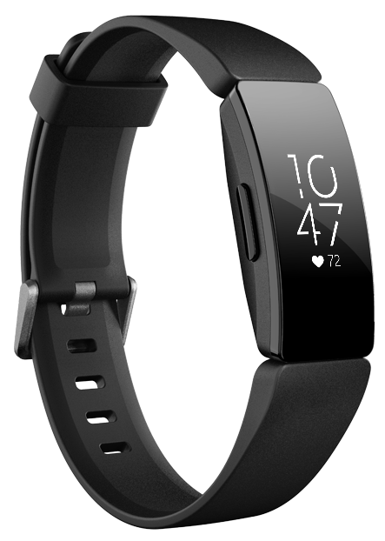
Current Market Products
Current wearable on the market have Heart Rate monitoring
Small and light
Mi band 4
FitBit
Inspire HR
Notes:
What are the current market products and what do they value do they offer?
https://www.mi.com/tw/mi-smart-band-4/
https://marketing.fitbit.com/images/product-listing/desktop/inspirehr-black-0-f94785486bdda8a916d2afd3ae983d5e.png

Slide 32
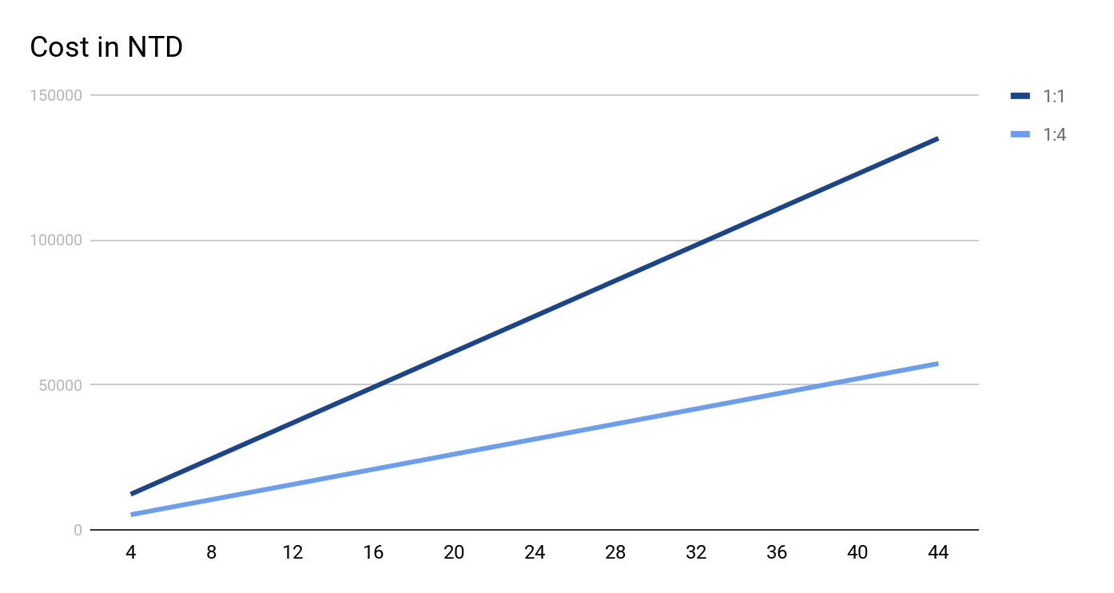
Improve Scalability
How well does it scale?
Is the solution cost effective at larger scales?
Notes:
How well does it scale?
Is the solution cost effective at larger scales?

Slide 33
Changes
Improved monitoring mobility
Increase device connectivity

Slide 34
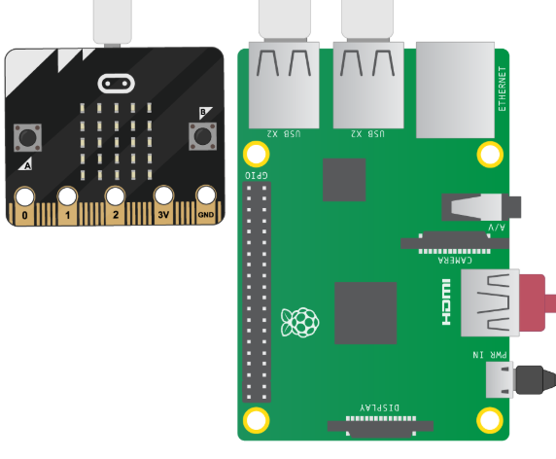
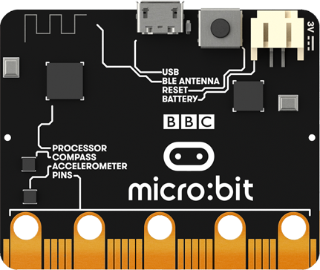

Improve Monitoring Capability
BBC Micro:bit
( Master unit)
BBC Micro:bit
( Slave unit)
pulse sensor
Base Station
Master Micro:bit : Temperature sensor
Wearable
Pulse sensor: heart rate (BPM & AVG)
Button A : Average BPM Status
Button B : Call CNA
Notes:
Heart Rate sensor to the microbit to improve monitoring ability of system instead of just at base-station.

Slide 35
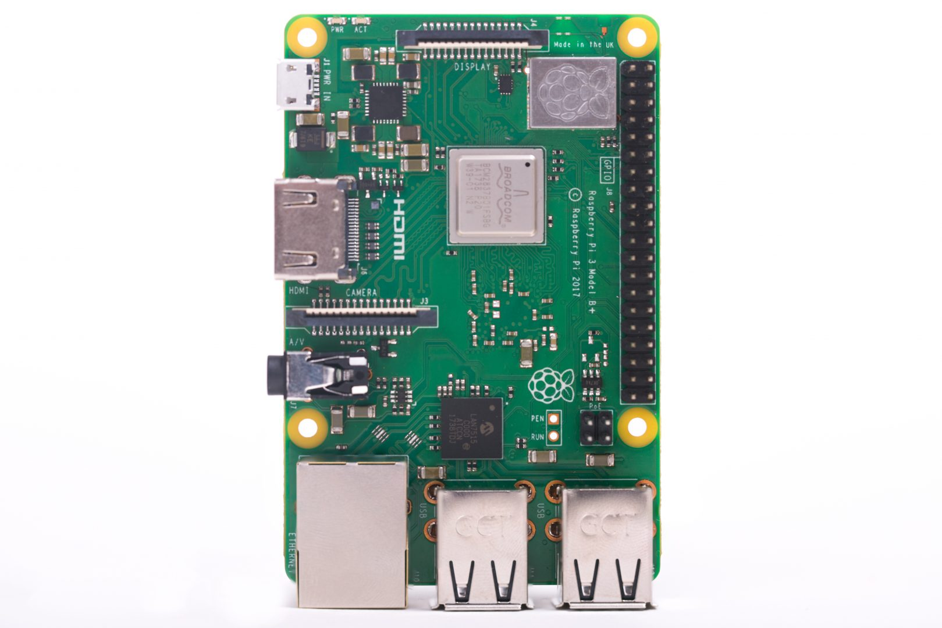

Increase device connectivity
Ethernet
Firebase
Raspberry Pi 3 B
Radio
Master Micro:bit
Notes:
Not done yet. Multi connect possible. but data-collisions occur. Need to figure out some method to ensure smooth communication such as Three way handshake.

Slide 36
Increase device connectivity
Ethernet
Firebase
Raspberry Pi 3 B
Radio
Master Micro:bit
Notes:
Not done yet. Multi connect possible. but data-collisions occur. Need to figure out some method to ensure smooth communication such as Three way handshake.

Slide 37
Improve Scalability
Notes:
How well does it scale?
1:1 1890 + (930) + 250 = 3070 *4 = 12280
1:! 1890 + 465 +465*4 (1860)+1000= 5215
0.424674267

Slide 38
Improve Scalability
Residents | 1:1 | 1:4 | Difference | Factor
4 | 12280 | 5215 | 7065 | 0.4246742671
8 | 24560 | 10430 | 14130 | 0.4246742671
12 | 36840 | 15645 | 21195 | 0.4246742671
16 | 49120 | 20860 | 28260 | 0.4246742671
20 | 61400 | 26075 | 35325 | 0.4246742671
24 | 73680 | 31290 | 42390 | 0.4246742671
28 | 85960 | 36505 | 49455 | 0.4246742671
32 | 98240 | 41720 | 56520 | 0.4246742671
36 | 110520 | 46935 | 63585 | 0.4246742671
40 | 122800 | 52150 | 70650 | 0.4246742671
44 | 135080 | 57365 | 77715 | 0.4246742671
Notes:
How well does it scale?
1:1 1890 + (930) + 250 = 3070 *4 = 12280
1:! 1890 + 465 +465*4 (1860)+1000= 5215
0.424674267

Slide 39
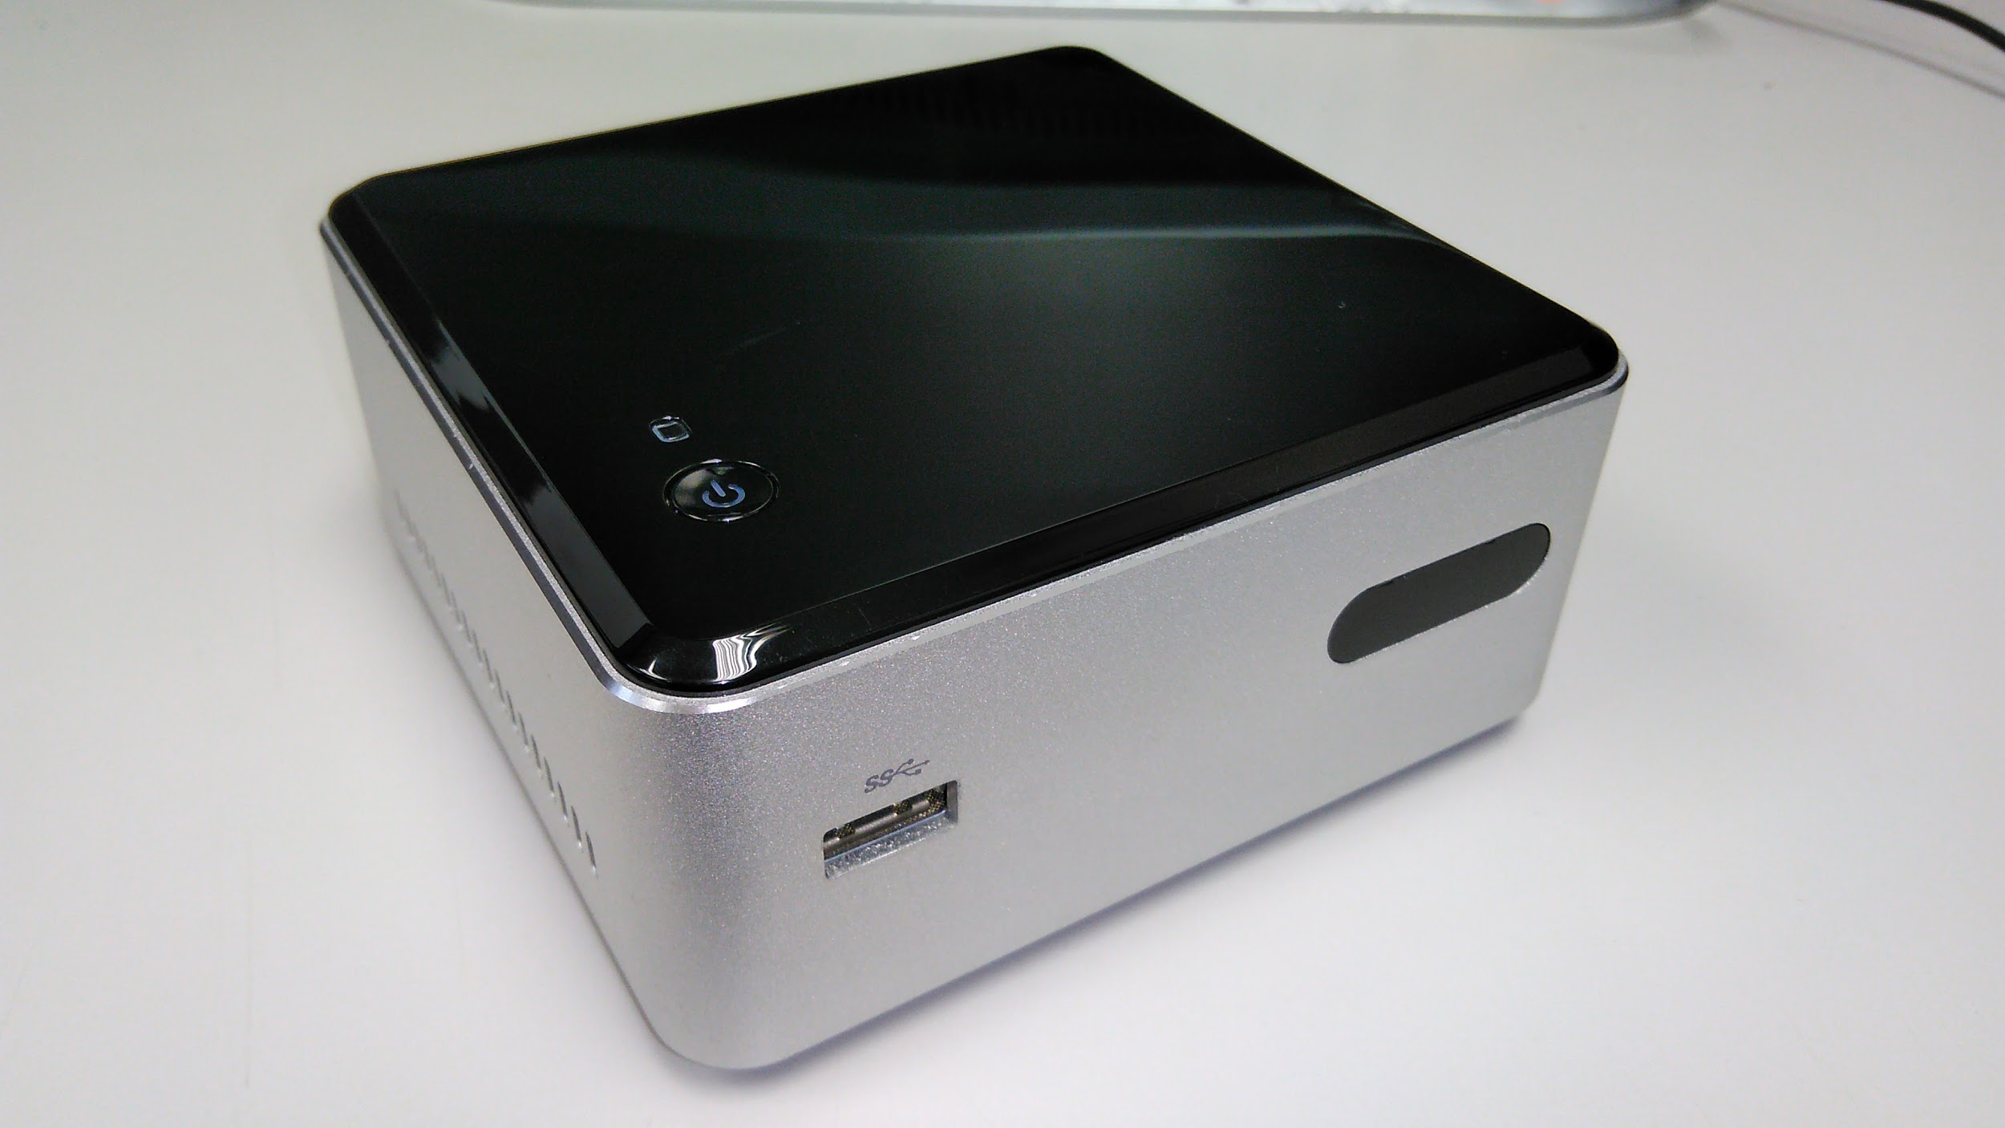
Other Tasks
Notes:
Introduce the team member

Slide 40
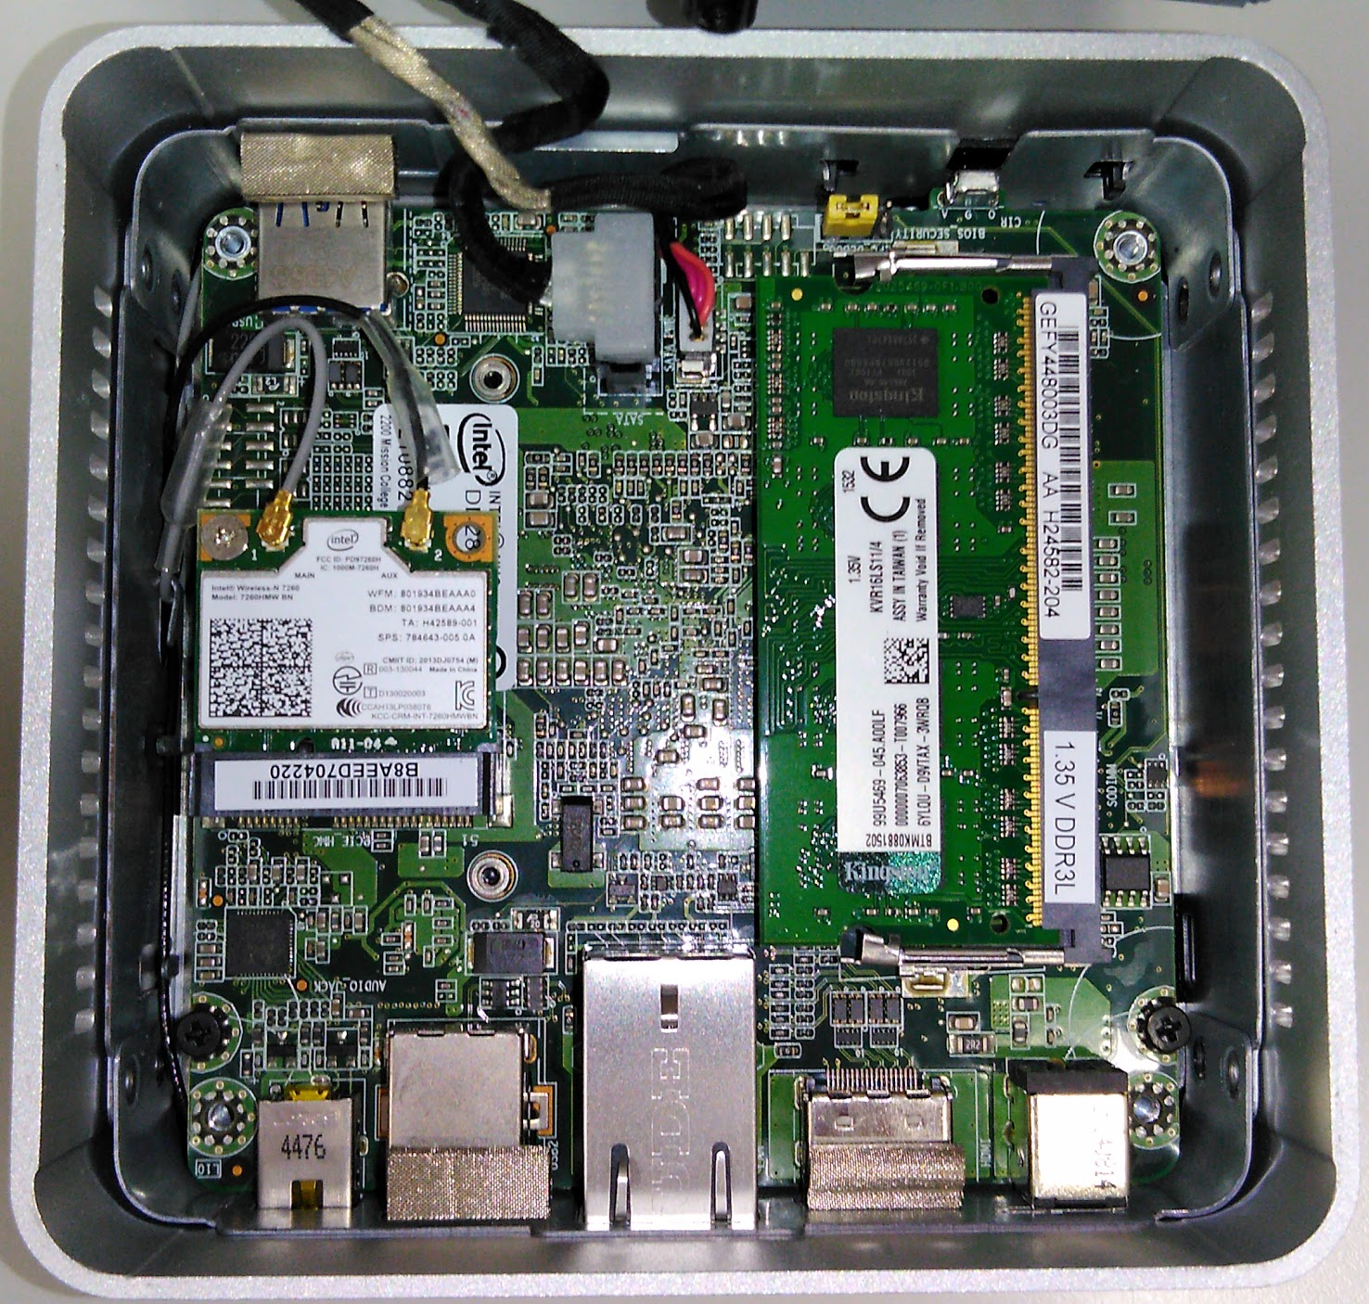

Setup server to run Back-End code
The server runs Python code responsible for generating the graphs and PDF file for reports.
Uses Matplotlib to generate graphs based on the selected resident ID and range of dates.
Notes:
The server runs Python code responsible for generating the graphs and PDF file for reports.
Uses Matplotlib to generate graphs based on the selected resident ID and range of dates.
We chose this unit due to its cost effectiveness on our small scale, and it is energy efficient. Linux Mint 18.2 Operating system was chosen to keep budget low and it Linux systems in our experience are quite reliable at staying online wihtout reboot for weeks.

Slide 41
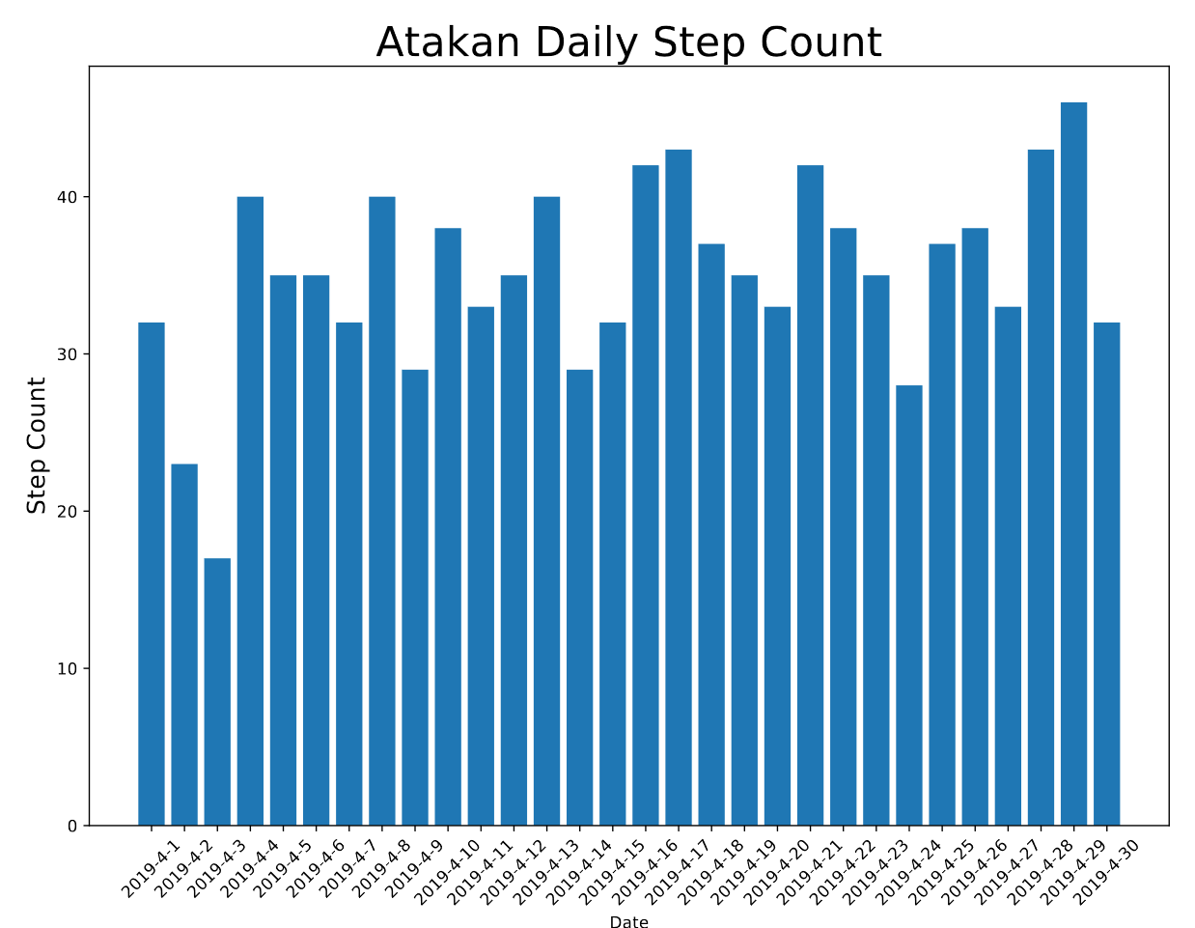

Slide 42
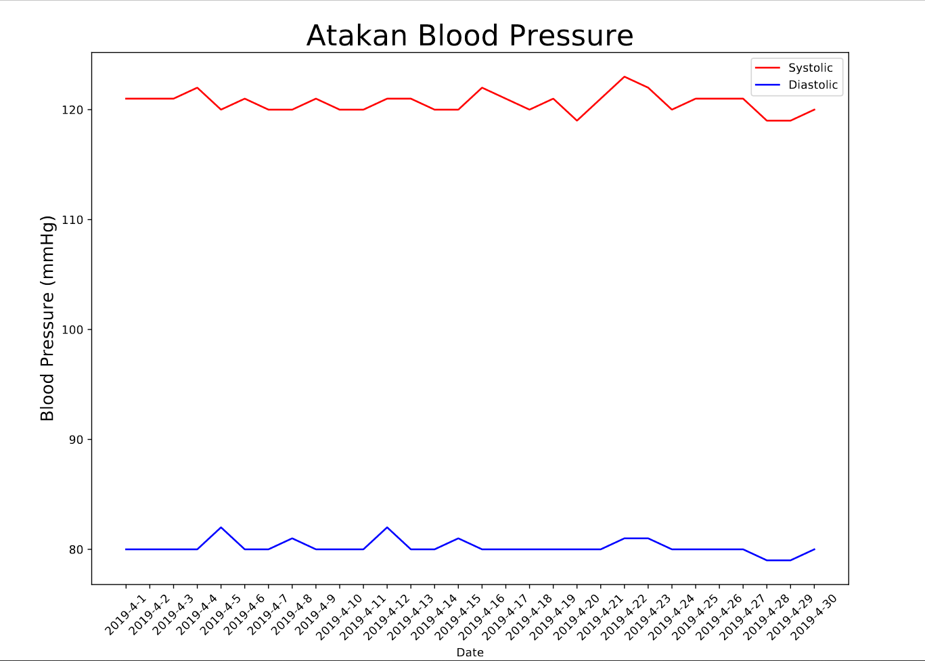

Slide 43
BROWSER TEAM
Notes:
Introduce the team member

Slide 44








Tools & Software
Tools & Software
Windows OS
Visual Studio code
Node.js deployment tools
Firebase
Language
HTML
CSS
Javascript
jquery
Notes:
In the browser team all the coding is done in the Windows OS environment. For the code editor Visual Studio code is used to edit the code because the functionality and the extension that make the coding work easier. Deploying the code to the hosting database we use node.js, for the database and hosting we use firebase which is a mobile and web application development platform developed by Firebase.
In languages aspect we code in HTML and CSS mainly for the frontend of the browser, while for the backend code is mainly done using Javascript. To support and help the coding in Javascript we also use jquery, jquery is a JavaScript library designed to simplify HTML DOM tree traversal and manipulation, as well as event handling, CSS animation, and Ajax.

Slide 45

Users :
Director and CNO
IT admin
Focus :
Data viewing
Data Record
Quality Control of the LTC
Technical control of the system
Goals :
View center status
Managing center task and activity
TMS
Notes:
In the browser component of the LTC Task Management System the main focus for the users are director and CNO, and IT admin. The director and CNO has the same type of account which mostly handle data viewing, data record, and also quality control of the LTC. The director and CNO can access all the crucial data of the LTC remotely, they even able to build and assign task to the other component of the LTC TMS. The activity of managing of the Long Term Care Centre can be done easily with the help of the system by using the database there are less paperwork and everything will be handled digitally.

Slide 46
User
Interface Map
Notes:
Kevin

Slide 47

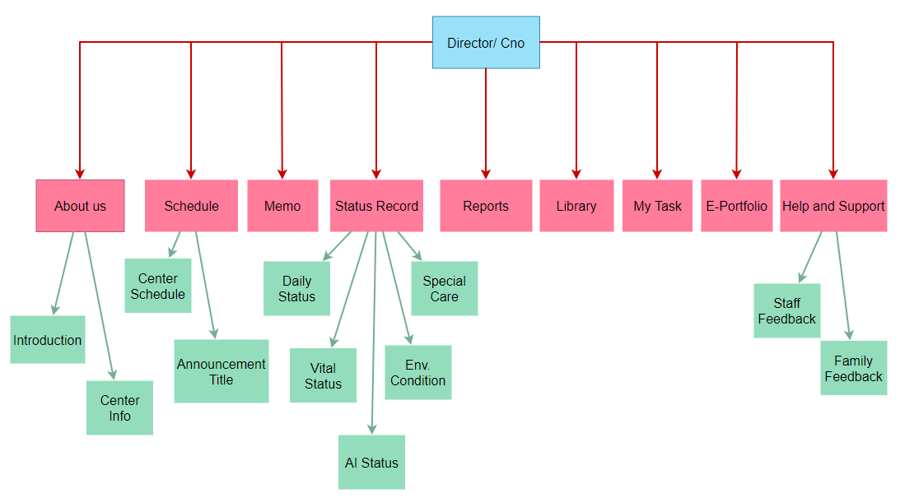

Slide 48

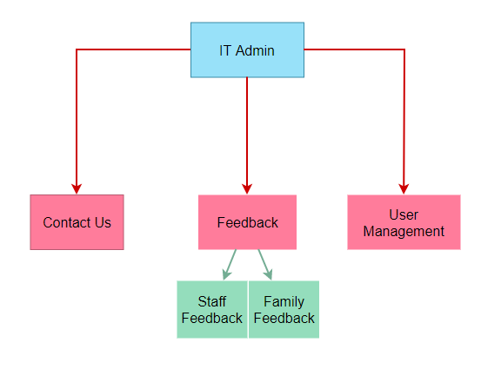

Slide 49
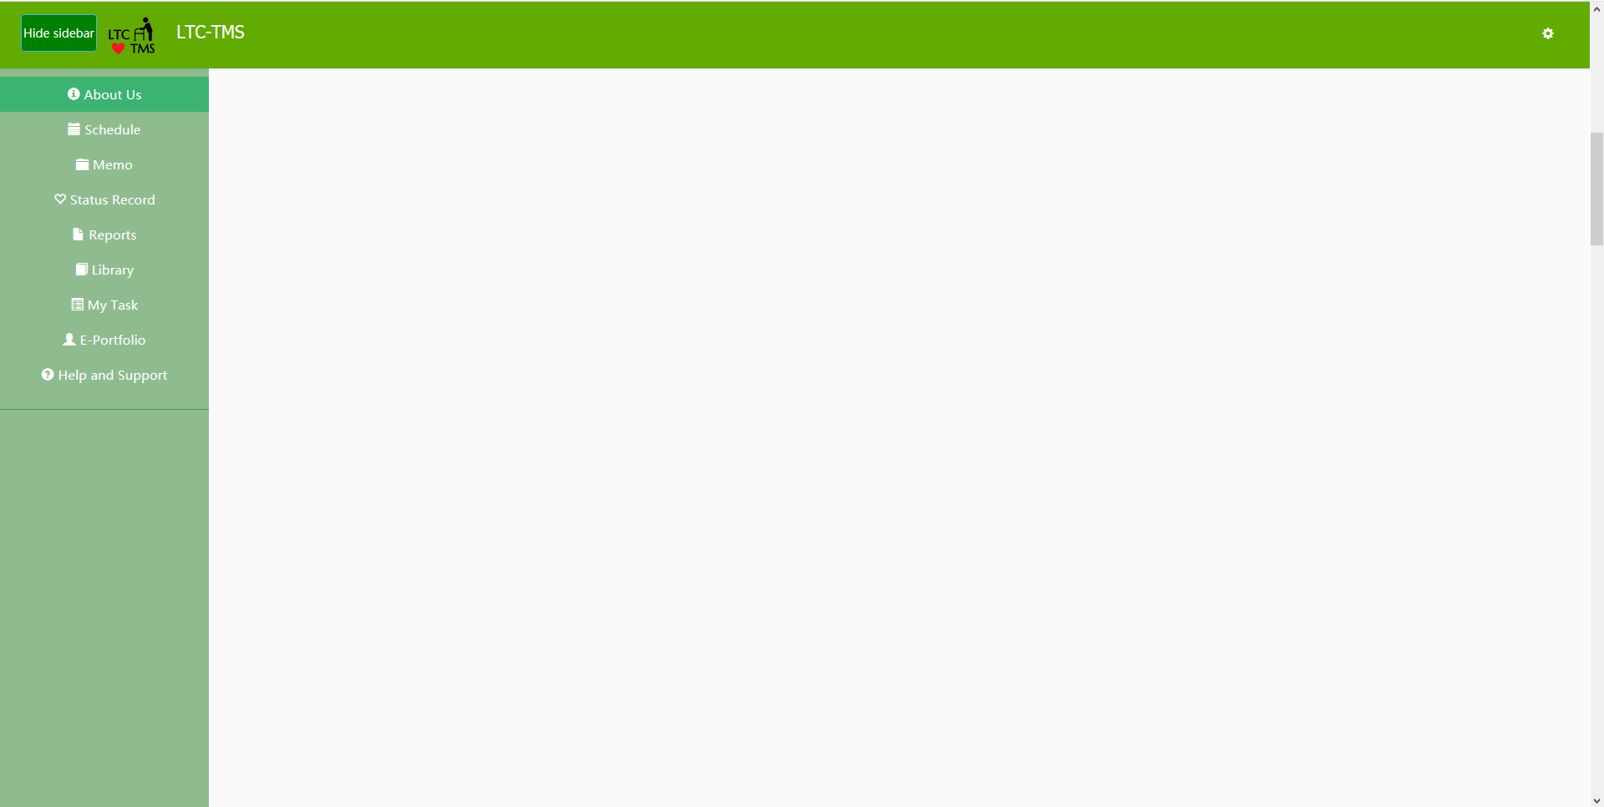
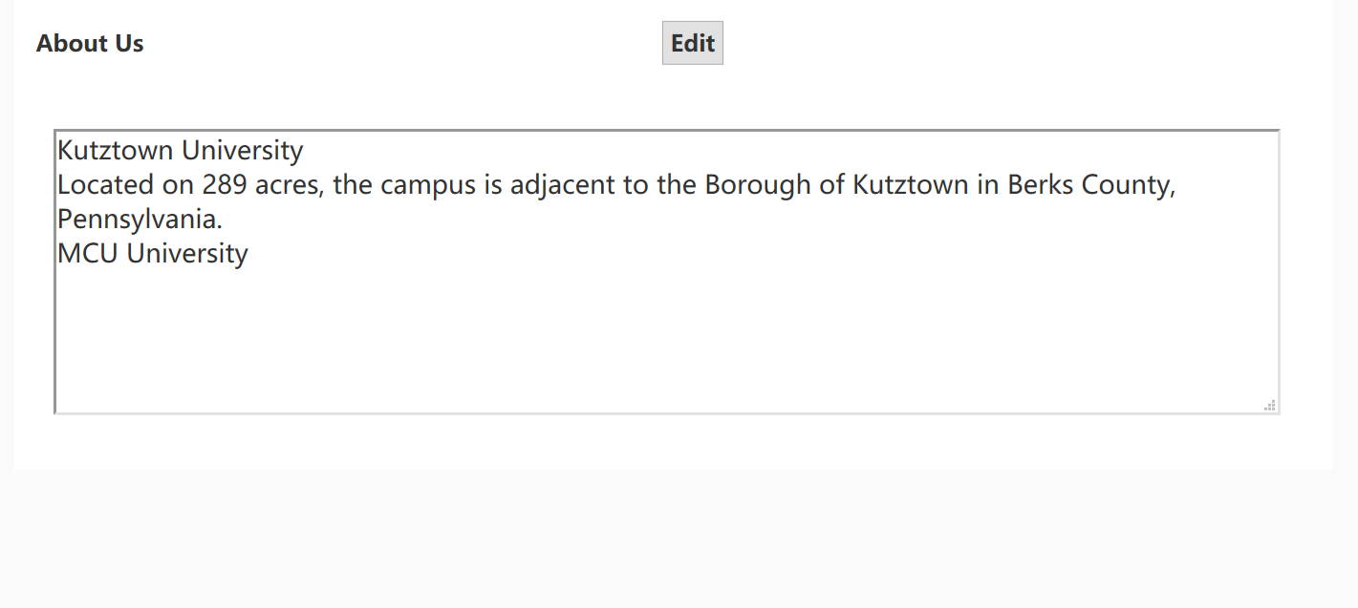
About Us
Aims
Make the page more efficient and effective in terms of space
Better UI
Features
Clear the blank space and the unused area
Notes:
In the past, there is a waste blank space, we think is not efficient and effective.
Now we clean up the part that has the blank page.

Slide 50

CODE OF ABOUT US

Slide 51


E-Portfolio
Aims
Prevent the sorting bar to block the table
Better UI
Features
Change the filter bar
Redesign the table
Notes:
We think that the sort and search bar in the old browser is not very easy to use because it will cover the table if we show the sort and search bar.
Now we move the bar to the top of the page , and make it permanent so that the search criteria is always visible to the user at a glance and does not cover the data table.

Slide 52

CODE OF E-PORTFOLIO

Slide 53



Slide 54

Status Record
Aims
Get the status record of the patient from the app and hardware
Features
Able to track the status of the patient that the app and hardware update
Notes:
Leon
For status record function, we finish the function based on the template.
daily status, meals and other activities.
vital status, Blood pressure and temperature.
AI status, data from wearable hardware.

Slide 55

Code for Status Record Page

Slide 57


Help and Support
Aims
Get a feedback on the LTC from the family and staff
Result
Complete the template that the last year’s KU team gave us
Notes:
Leon
To get the feedback of the LTC from family and staff. User can write the feedback by the app and send it to the database.
Those feedback will show on the table in

Slide 58

Code for Help and Support

Slide 60


User Information
Aims
Reduce page clutter
Follow established industry best practices
Features
Move the user information to the drop down list together with language setting
Notes:
Francois
Talk about a little of bit of the technical stuff

Slide 61


Slide 62


Slide 63


UI change
Color
Increase readability and user friendly color
Consistent color theme with other system components
Translate
Chinese translation is available in the website
Notes:
Francois

Slide 64


Slide 65



Slide 66


Problem and Difficulty
Establish firebase environment
Database transfer from KU to MCU account
Connectivity of the database
Authentication problem
Data display on the browser from the database
Notes:
Kevin

Slide 67
Future Proposed Implementation

Slide 68


Schedule
Aims
Increase functionality
Better UX
Features
User able to add events on the calendar
User able to view the calendar in monthly, weekly, and daily view.
Integrate the system to Google calendar to make easier scheduling
Notes:
*do a demo for the calendar check the hourly and weekly event
Kevin

Slide 69

Calendar
Aims
Increase functionality
Better UX
Features
User able to add events on the calendar
User able to view the calendar in monthly, weekly, and daily view.
Integrate the system to Google calendar to make easy scheduling
Notes:
*do a demo for the calendar check the hourly and weekly event
Kevin
The calendar is more convenient by using google calendar any synchronized users can get update and notification from their calendar app from their phone

Slide 70

Code for Calendar
Notes:
We call the Fullcalendar function and use their calendar template
Plug-in: Interaction- You can click on a certain date and add events
Day-grid- Able to see the day grid view
Time grid: Will show the time hourly in the grid view
Business hours: Differentiate the color of weekday and weekend

Slide 71

Code for Calendar
Notes:
call the mcultc gmail API key
Eventclick triggered when user click an event. it will open the events in a pop up window
Loading : This function is often used to show/hide a loading indicator

Slide 72
Industry Best Practices

Slide 73

Account Options
Removed Profile bar from old version
Follow established industry design conventions, such as the Google Account button.
Combine Logout option with language options.
Notes:
Removed Profile bar from old version Because we don’t need to see the user info all the time, and it takes up a lot of usable screen space)
Follow established industry design conventions, such as the Google Account button.
Combine Logout option with language options.
Basically, this is part of the guiding philosophy that less frequently used buttons, or unimportant elements get less screen space and screen time so that the intended users can focus on productivity

Slide 74



Search and Sort Bar
Search bar is permanently visible at the top of table so that it doesn’t obstruct data
Search Criteria is always visible and easily accessible to accommodate better productivity
Notes:
We removed the old animation for the search bar which was visually impressive, but we believe was more negative towards productivity. Now it is permanently at the top in a position that doesn’t obstruct data
Search criteria is also visible and easily accessible so that you don’t want to click around and wait for them to appear.

Slide 75
APP TEAM
Notes:
atakan

Slide 76





Tools & Requirements
For ios & Android:
Software
Visual Studio
React Native
Hardware
Macbook Pro(macOS Mojava 10.14.3)
iPhone X(ios 13.1.2)
Various Android devices
Windows computers
Notes:
atakan
Tools for your App development

Slide 77

Users :
CNA and Family
Focus :
Data viewing
Data Recording
Sending Feedback
Goals :
View patient status
Send feedback and report to Firebase
Mobile
(Android & iOS)
Notes:
atakan

Slide 78
User
Interface Map
Structure of iOS & Android Version
Notes:
jimari

Slide 79



CNA
Notes:
jimari
this is the interface map for our mobile devices
this shows the different menus and screens that are available for the CNA to navigate through
so you can see the main screens such as Center info, Library, Home Screen, Patient Record, User Portfolio and their sub levels

Slide 80

Family
or
Patient
Notes:
jimari
the main difference between the CNA and Resident/Family account is the Add patient status only the CNA can add patient/resident status

Slide 81


Login Page
Aims
Clearer “page” design
More user friendly
Features
New Password Visibility toggle
Automatic account type detection
Keyboard shortcut
Visible textboxes
Notes:
atakan
left is old right is new, emulator running for demo as we are explaining the screens and functions
Clearer “page” design
More user friendly
Features
New Password Visibility toggle
Automatic account type detection
Keyboard shortcut
Visible textboxes

Slide 82

Part code of Login Page
Notes:
in the old code we had two different if catch statements that would check whether you entered the right password for both cna and family accounts, now i have combined those statements so that we can remove the toggle button.
the first part of the code checks whether you typed the correct password for the cna accounts, if that is not the case it catches the error and assumes that you typed a family account and checks again if you typed the right password for that respected family account.

Slide 83


Home Page
Aims
Clearly defined/separate announcements
Better visibility and user friendly
Features
Swipe function to navigate through different announcements
Added support for images in Announcements
Notes:
jimari
home page/announcements page of the app
see announcements issued by the administrators on the browser side
you can see the announcement title, date and its details
swipe function to swipe through the different announcements and see their contents
app← firebase←browser

Slide 84

Part code of Home Page

Slide 85

Part code of Home Page

Slide 86


Patient Records
(For CNA)
Aims
Easy to use design
Separation of Portfolio and Patient Record
Features
Patient selection on the main screen to prevent repetitive selection.
Changes
Name:Portfolio -> Patient Records
Moved the user’s profile information to the log out screen
Reduced repetition of selecting patients in each page
Notes:
Angela
I would talk about record part. This screen is for the CNAs
This screen is for patient records where u can display and add new records to firebase.
Firstly,In the old version, this screen was called portfolio. The user’s portfolio was in this page .Now In our version, we have changed the name to patient records and we have moved the user’s profile information to the log out screen. This is to separate user profiles from patient records, so that the function of this page is clearer to user.
Secondly, we have reduced repetition of selecting residents in each page. In the old version, users needed to select the resident ID every time in each page(Add Daily status/ Check Daily status/Check AI status/Add vital status/Check Vital status).
Now in our version, users can select patient ID in the patient records screen only one time and then they can open all status pages without needing to select patient ID again.

Slide 87



Part code of Patient record
Notes:
This page is the part code of patient record. In the first page of code, if for check the user is CNA or not. If the user is CNA, then the user can select patient ID in this page to record the data or check the data. The second page of code is to fetch the data of patient in Firebase. After CNA select patient ID , the variable in the code would called this.state.patient, and that variable will be accessible to further process in each page(ex. DailyStatusAdd)

Slide 88


Daily Status Add
Aims
Combining AM/PM activities into one
Collapsible items for easy viewing.
Features
Exact time entry for detailed reports
Notes:
Angela
This screen is Daily Status Add. CNA can add the status of residents in this page.
We have improved the content support of daily status in this page as well as changed the design. The design is now simplified, with AM/PM activities combined into one listing.
Listings, are organised into categories such as sanitation, dietary conditions etc.
All records have also been changed to record the exact time they were performed.

Slide 89

Daily Status Add
Before
Now
Shower
Dental care
Shampoo
Shave
Haircut
Wash Face
Sanitation
Behavior
shower
ate
brush teeth
poop time
urinate time
Dietary Condition
7. Breakfast
8. Lunch
9. Dinner
Basic Care
10.Turn over/Back care
Defecation/Urination
11. Defecation
12. Urination
Notes:
Angela
About the content
In the old version, the content of daily status only have shower, ate, brush teeth, poop time and Urinate Time.
Now in our version,we have 12 statuses and we divide 12 statues to 4 group - Sanitation Behavior/Dietary Condition/Basic Care/Defecation(Urination)..
This is what CNA records every day in a real Long term care

Slide 90


Vital Status Add
Aims
Easier data entry
Allow additional information
Features
Text box to enter specific information
Description area to accept detailed
Notes:
Angela
This screen is Vital Status Add. CNAs can add the vital statuses of residents in this screen.
We changed the design of the data input make the record taking process more intuitive. We also added “special case record”, a text entry field for additional notes. This is to record the abnormal conditions in the residents such as poor breath or other abnormalities. If there is nothing to add, the Special Case Record box can be left empty in the submission.

Slide 91


Patient Record
(For Family)
Aims
Clean, easy to use design
Larger, easy to read text
Features
Check Patient status
Notes:
vincent
Same things as the design in CNA
We made the buttons clearer, and added icons for each function
This is example of Access control: The app disables record adding, or viewing of other residents’ data for non-CNA users. You can see the users’ options are only to check the status, not add records to the status.

Slide 92


Daily Status Read
Aims
More reader friendly format
Easier navigation
Features
List-view of each activity
Notes:
atakan
This screen is Daily Status Read. this page lets CNA and family check the vital status of patients.
in this page we changed the UI design of this page to make user can see the record clearly.
changed the text and theme colours to improve text readability.
we also added the new variables that did not exist in the 2.0

Slide 93


Library
Aims
Clear separation of tasks and task details
Features
Added link to videos in YouTube application
Description notes and pictures in each task listing
Notes:
Vincent
So compared to the old version, each task entry is clearly separated by a line. Support for images, and a links to external video applications for improved content.

Slide 94


Center Info
Aims
More reader friendly formatting
Features
Scroll wheel to select date
Submit feedback button to send feedback
Call center that triggers a phone call to the LTC
Notes:
Vincent
Text is no aligned in a clear to read manner. Buttons are redesigned to be clearer.

Slide 95

Submit Feedback
Aims
Easy way to submit feedback to the relevant LTC personnel
Features
Toggle switch for feedback type
Message area to type feedback and submit to the LTC
Notes:
Vincent
Page is mostly unchanged. Only changes are the design to keep it with the new theme of the app.

Slide 96

Call Center
Aims
Easy way to communicate with the LTC via Phone Call
Features
Auto dial of the LTC on the mobile device in order to make a call.
Notes:
Vincent
Page is mostly unchanged. Only changes are the design to keep it with the new theme of the app.

Slide 97


Portfolio
Aims
Easily seen user information
Features
Display picture of the user
Detailed user information

Slide 98

Log Out
Aims
Easy and efficient way to Log Out of the account
Features
Pop up screen that makes sure you want to log out
Notes:
Atakan
We change the logout button to the upper right to make space for more important buttons in the bottom navigation bar.

Slide 99


Part code of Log Out
Notes:
This page is the part code of Logout screen. I moved Logout Button to upper right corner . TouchableOpacity: When you click on the button, the opacity of it will change in order to give the user a feeling of pressing the button.

Slide 100
Industry Conventions

Slide 101

Clearer Page layout
One of the main purposes of the app is data recording and viewing
Line dividers and clear separation between buttons and screen elements for better “at a glance” clarity
Notes:
One of the main purposes of the app is data recording and viewing
Line dividers and clear separation between buttons and screen elements for better “at a glance” clarity

Slide 102
Clearer Page layout
Better contrast between visual elements
Consistent design
Notes:
Colours are chosen to give clear contrast between visual elements. Buttons and bar POP out from the page
Buttons on the same page are the same size for visual consistency.

Slide 103


Icon size and position
The buttons to access root pages are placed at the bottom of the app and are at a reasonable size.
The app interface is designed in such a way to make sure that users do not have to go through more than 2 layers to access a page or function
Notes:
The buttons to access root pages are placed at the bottom of the app and are at a reasonable size.
The app interface is designed in such a way to make sure that users do not have to go through more than 2 layers to access a page or function

Slide 104
Support Teams

Slide 105


QA Team
What we do
Automated Testing
Manual Testing
Ensure a High Quality Product
Leader: Jimari
Members: Annie, Francois

Slide 106



What did we use?
Mobile Devices
Katalon Studio
Laptops
Notes:
need to make sure our system can run on mobile and browser
also make sure the iOS, android, windows and Mac are functioning the same
generate scripts by recording actions in katalon and are able to play back later to make sure we have same outcome
We also document test cases
and follow our progress using indexing

Slide 107


A sample of our test cases
Notes:
due to time constraints we can only show you a sample and if you wish you can view the specifications and test document

Slide 108


Severity Index and Tracking

Slide 109

DB Team
What we do
Setting environment
Modify schema structure
Stabilize connection
Leader: Leon
Members: Eva, Vincent

Slide 110

This is database that is accessed by and recorded to by the Browser, APP and Hardware teams.
Each data representative from each team will modify their the data structure according to their needs.

Slide 111

Backup Database

Slide 112
Q & A
Q & A

